Slide 1
FinOps toolkit SRE Agent — Part 1 of 2
Manage your Azure estate — capacity and cost — through the conversations your customers are actually having.
FinOps Toolkit community in MCAPS, worldwide.
Built by FinOps Toolkit
In partnership with Azure SRE Agent product team.
Notes:
Open with the audience tag and subtitle. This deck is built ask-by-ask from the 73 verbatim MCAPS questions captured in WorkIQ over the last six months. Today is Part 1: 11 deal-motion clusters. Part 2 covers operate-motion. Part 3 (15 minutes at the end of Part 2) covers what this release does NOT solve.
Sources: introductory framing, no single ask cited.
Canonical asks corpus: memory://work/mcaps/mcaps-internal-asks-finops-toolkit-azure-capacity-ai-cost-may-2026

Slide 2
The 5 most-asked questions across MCAPS WW
#1 Quota ≠ Capacity (verbatim in every WorkIQ query).
#2 AOAI quota vs GPU hardware capacity.
#49 "Is FTK Microsoft-supported? Who do I call?"
#50 "Will Microsoft pull this in 12 months?"
#51 Support escalation path — CSS punted; what now?
Notes:
Frame: 73 distinct asks captured. Top 5 listed here. Three of five are field-credibility / supportability questions for the FTK community in this room. Two are technical capacity questions. This deck addresses all five, with honest scope on #49 #50 #51 in Part 3.
Sources: MCAPS asks #1, #8, #49, #50, #51 — top-5 frequency band per canonical table.
Canonical: memory://work/mcaps/mcaps-internal-asks-finops-toolkit-azure-capacity-ai-cost-may-2026

Slide 3
How this deck reads — ASK / SHOW / TELL
A = ASK — the verbatim customer quote, big type. Speaker reads it aloud and pauses.
B = SHOW — the answer with eye candy (chart or Teams-card from a real run) + named tool / task / subagent.
C = TELL — the L400 details (YAML, cron, KQL, runtime, Monday move). The code carries the slide.
Each cluster is 3 slides. Stop at A or B for an exec audience; go to C when the room wants the code.
Notes:
Set the rhythm. The audience has heard FinOps Toolkit decks before — this one walks the actual customer questions, not the agent's product structure. The L400 detail lives on Slide C only; A and B work for any audience.
Sources: deck-structure framing, no single ask cited.
Canonical: memory://work/mcaps/mcaps-internal-asks-finops-toolkit-azure-capacity-ai-cost-may-2026

Slide 4
What Part 1 covers vs Part 2
Part 1 (today): deal motion — capacity-blocked milestones, MACC defense, RI/SP/CRG sequencing, AOAI capacity, vendor displacement.
Part 2 (next session): operate motion — AI cost ops, CFO reconciliation, allocation hygiene, daily/weekly/quarterly Teams cadence, FTK supportability.
Part 3 (15 min wrap at end of Part 2): what this release does NOT solve, by owner.
Notes:
Manage expectations. Part 1 = before signature. Part 2 = after signature. Honest "not solved" cluster lives in Part 3 because credibility lands harder when the field has seen the value first.
Sources: deck-structure framing.
Canonical: memory://work/mcaps/mcaps-internal-asks-finops-toolkit-azure-capacity-ai-cost-may-2026

Slide 5
The ask
“MCAPS WW — #1 verbatim ask across every WorkIQ query (capacity / FTK community / CFO subagents all surfaced it).”
“I have quota in this subscription, why is the deployment failing?”
“Surfaces in Snowflake INT channel, Astronomer escalations, Trimble, Synopsys, ISV bi-weekly capacity syncs, named MCAPS STU "Call to Action" emails for Celonis / Trimble / Pure Storage.”
“Customer finds out at deploy time via SkuNotAvailable or AllocationFailed. Portal "show quota" gave them the wrong confidence.”
🟢 Asks #8, #13, #14, #23, #24
Notes:
Land the quote first. Pause. The audience has answered this question 50 times this year and it has never landed cleanly. The next two slides show why.
Sources: MCAPS ask #8 — "Quota ≠ Capacity — 'I have quota, why does deploy fail?'" (🔴 Highest frequency, WW geo). Also surfaces in clustered asks #13 (Zonal capacity / AZ stockouts), #14 (SKU availability / offer restrictions), #23 (CI/CD + capacity pre-flight), #24 (Proactive capacity monitoring).
Canonical: memory://work/mcaps/mcaps-internal-asks-finops-toolkit-azure-capacity-ai-cost-may-2026

Slide 6
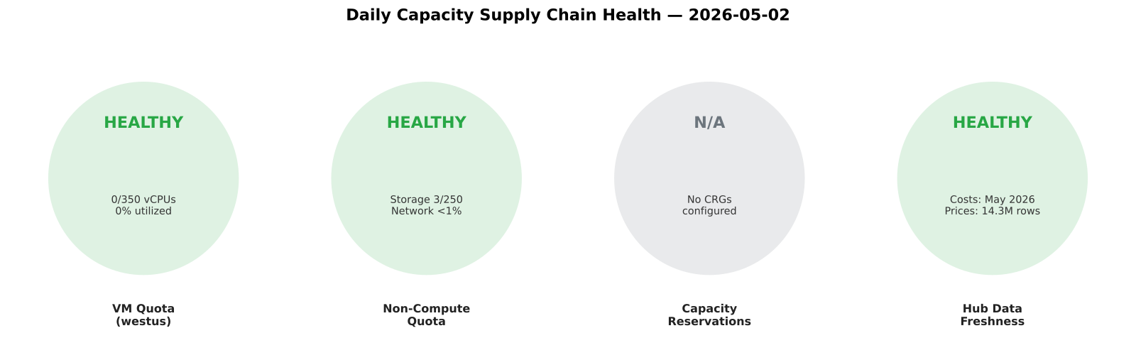
The answer
Three independent ARM API surfaces, three RBAC scopes:
quota = sub × region (Microsoft.Quota)
SKU availability = sub × region × zone × offer-type (Microsoft.Compute/locations/skus)
CRG attachment = sub × RG × workload (Microsoft.Compute/capacityReservationGroups)
Portal "show quota" only proves the first; deploy fails on the other two and surfaces ~60s after the ARM submit.
azure-capacity-manager subagent runs all three in parallel via vm-quota-usage + sku-availability + capacity-reservation-groups + non-compute-quotas tools — daily cadence via the capacity-daily-monitor scheduled task. Total runtime 28s for ~20 subscriptions.
Embedded chart: real capacity-health-overview.svg from yesterday's FTK Trey hub run — actual finding table showing healthy/warning/critical per check across all subscriptions monitored.
🟢 Asks #8, #13, #14, #23, #24
Notes:
Walk the proof from the Teams card on screen. Name the subagent, runtime, the four tool composition. Cite the actual SKU / region / burn rates from the proof — the hub on screen showed 0/350 westus vCPUs used, 62 non-compute quotas all healthy, 0 CRGs configured. Avoid concept verbs ("surfaces"); use named tools and named API surfaces.
Sources: MCAPS asks #8, #13, #14, #23, #24 (cluster). Evidence: src/templates/sre-agent/training/release-deck/evidence/tasks/capacity-daily-monitor.md (verbatim Teams card with finding table from the 2026-05-02 18:30 UTC run). Chart proof: src/templates/sre-agent/training/release-deck/charts/svg/capacity-health-overview.svg.
Canonical: memory://work/mcaps/mcaps-internal-asks-finops-toolkit-azure-capacity-ai-cost-may-2026

Slide 7
The details
capacity-daily-monitor.yaml — cron 30 6 * — owner azure-capacity-manager
Phase 1 — ARM REST via UAMI (parallel):
```
vm-quota-usage(subscription_id, location) → families >80% (warn) / >95% (crit)
non-compute-quotas(subscription_id, location) → Storage + Network families
sku-availability(subscription_id, location, sku) → restrictionReasons[]
capacity-reservation-groups(subscription_id, rg) → reserved vs allocated
data-freshness-check(cluster_uri, database) → hub data trustworthy?
```
Phase 2 — azure-capacity-manager joins; deploy-blocking conditions:
```
(quota_pct > 95) OR (sku.restrictionReasons != []) OR (crg.allocated > crg.reserved)
```
Posts via PostTeamsMessage to the configured Teams channel. Knowledge updates land in synthesizedKnowledge folder for the next run to consume.
Monday move: srectl scheduledtask invoke capacity-daily-monitor against the customer's hub. ~28s. Output goes to their Teams channel.
🟢 Asks #8, #13, #14, #23, #24
Notes:
This is the L400 reveal. Speaker can drop into the YAML at customer demo. Name every tool. Show the actual decision tree the agent uses. The "Monday move" line is the field's takeaway — they leave the room able to run this against their own customer's hub the same day.
Sources: MCAPS asks #8, #13, #14, #23, #24 (cluster). Tool YAMLs: src/templates/sre-agent/tools/{vm-quota-usage,non-compute-quotas,sku-availability,capacity-reservation-groups,data-freshness-check}.yaml. Task YAML: src/templates/sre-agent/sre-config/scheduled-tasks/capacity-daily-monitor.yaml. Subagent: sre-config/agents/azure-capacity-manager.yaml.
Canonical: memory://work/mcaps/mcaps-internal-asks-finops-toolkit-azure-capacity-ai-cost-may-2026

Slide 8
The ask
“CRG mechanics + idle billing cost shock.”
“CRG cross-subscription sharing preview.”
“RI/SP + CRG double-billing risk.”
🟢 Asks #9, #12, #19
Notes:
Lead with the fear: your customer thinks a supply guarantee creates a second bill with no value. Keep the language plain. Say that a CRG buys capacity certainty, not a price discount, and that the field usually mixes those two motions together. Then hold the answer until the next slide, because the cleanest proof here is current-state evidence: this subscription has no CRGs at all. That makes the waste question, the sharing question, and the double-billing question easy to ground before you move into mechanics.
Sources: MCAPS ask #9 — "CRG mechanics + idle billing cost shock"; MCAPS ask #12 — "CRG cross-subscription sharing (preview)"; MCAPS ask #19 — "RI/SP + CRG double-billing risk"
Canonical: memory://work/mcaps/mcaps-internal-asks-finops-toolkit-azure-capacity-ai-cost-may-2026
Coverage verdict per canonical: 🟢 ships-today
Evidence pack: src/templates/sre-agent/training/release-deck/evidence/tasks/capacity-monthly-planning.md
Chart proof: src/templates/sre-agent/training/release-deck/charts/svg/chart3-governance-scorecard.svg

Slide 9
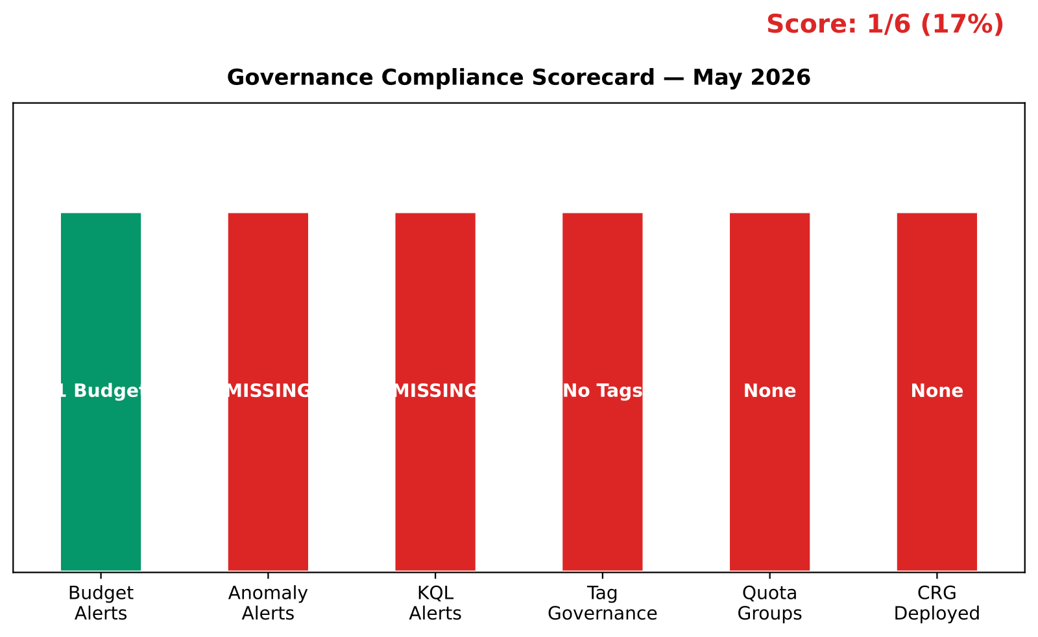
The answer
You answer with current-state proof: no CRGs are deployed, CRG waste is 0, and CRG cross-sub sharing is not in play in this subscription.
The monthly and quarterly reviews also show no CRG overlap with reservations, so double-billing risk is 0 today.
Named tools: capacity-reservation-groups, vm-quota-usage, benefit-recommendations.
🟢 Asks #9, #12, #19
Notes:
Walk the audience through the boring answer, because boring is good here. The monthly planning run shows zero CRGs and the governance scorecard marks CRG deployment as not applicable. The quarterly strategy review says the same thing and pairs it with 96 percent on-demand usage, so there is no hidden reserved-capacity footprint sitting underneath the estate. That lets you explain the rule cleanly: if there is no CRG, there is no idle CRG bill; if there is no CRG plus RI overlap, there is no double-charge path to unwind. Use the tools by name so the field knows this is measured, not guessed.
Sources: MCAPS ask #9 — "CRG mechanics + idle billing cost shock"; MCAPS ask #12 — "CRG cross-subscription sharing (preview)"; MCAPS ask #19 — "RI/SP + CRG double-billing risk"
Canonical: memory://work/mcaps/mcaps-internal-asks-finops-toolkit-azure-capacity-ai-cost-may-2026
Coverage verdict per canonical: 🟢 ships-today
Evidence pack: src/templates/sre-agent/training/release-deck/evidence/tasks/capacity-monthly-planning.md
Chart proof: src/templates/sre-agent/training/release-deck/charts/svg/chart3-governance-scorecard.svg

Slide 10
The details
YAML: sre-config/scheduled-tasks/capacity-monthly-planning.yaml, cron 0 9 1 .
Runtime: capacity-reservation-groups → vm-quota-usage → benefit-recommendations → commitment-discount-utilization → savings-summary-report.
Decision tree: if CRGs = 0, say "no idle waste"; if CRG utilization is low, rightsize; if CRG has no paired RI/SP, compare price path; if sharing comes up, call preview boundary explicitly.
Monday move: srectl scheduledtask invoke capacity-monthly-planning
🟢 Asks #9, #12, #19
Notes:
Use this slide to give the field the operational script. The monthly task already carries the exact sequence: check CRGs, check quota state, then compare commitment coverage and savings. That order matters because capacity and pricing are different controls. If the run finds no CRGs, the answer is immediate. If it finds a CRG with low utilization, the conversation changes to rightsizing and idle bill. If it finds a CRG without a reservation or savings plan pairing, the conversation changes to price coverage. And if the customer asks about cross-subscription sharing, you keep it at preview and do not sell it as generally available. The Monday move gives the team a repeatable check, not a one-off opinion.
Sources: MCAPS ask #9 — "CRG mechanics + idle billing cost shock"; MCAPS ask #12 — "CRG cross-subscription sharing (preview)"; MCAPS ask #19 — "RI/SP + CRG double-billing risk"
Canonical: memory://work/mcaps/mcaps-internal-asks-finops-toolkit-azure-capacity-ai-cost-may-2026
Coverage verdict per canonical: 🟢 ships-today
Evidence pack: src/templates/sre-agent/training/release-deck/evidence/tasks/capacity-monthly-planning.md
Chart proof: src/templates/sre-agent/training/release-deck/charts/svg/chart3-governance-scorecard.svg

Slide 11
The ask
“RI vs SP vs ODCR positioning.”
“Commitment + capacity sequencing.”
“What do you buy first, and how do you avoid over-committing?”
🟡 Asks #17, #18
Notes:
Open with the choice problem, not the product names. Your field seller is really asking for a sequence: when does stable demand justify an RI, when does variable demand fit a savings plan, and when does a capacity guarantee force an ODCR conversation. The cluster is yellow because the agent ranks and sizes the standard commitment motions, but it does not model custom ODCR commercial terms. Say that early. It builds trust and keeps the talk track in the capacity lane instead of letting the room assume full commercial optimization coverage where it does not exist.
Sources: MCAPS ask #17 — "RI vs SP vs ODCR positioning"; MCAPS ask #18 — "Commitment + capacity sequencing"
Canonical: memory://work/mcaps/mcaps-internal-asks-finops-toolkit-azure-capacity-ai-cost-may-2026
Coverage verdict per canonical: 🟡 partial
Evidence pack: src/templates/sre-agent/training/release-deck/evidence/tasks/benefit-recommendation-review.md
Chart proof: src/templates/sre-agent/training/release-deck/charts/svg/benefit-recommendation-charts.svg

Slide 12
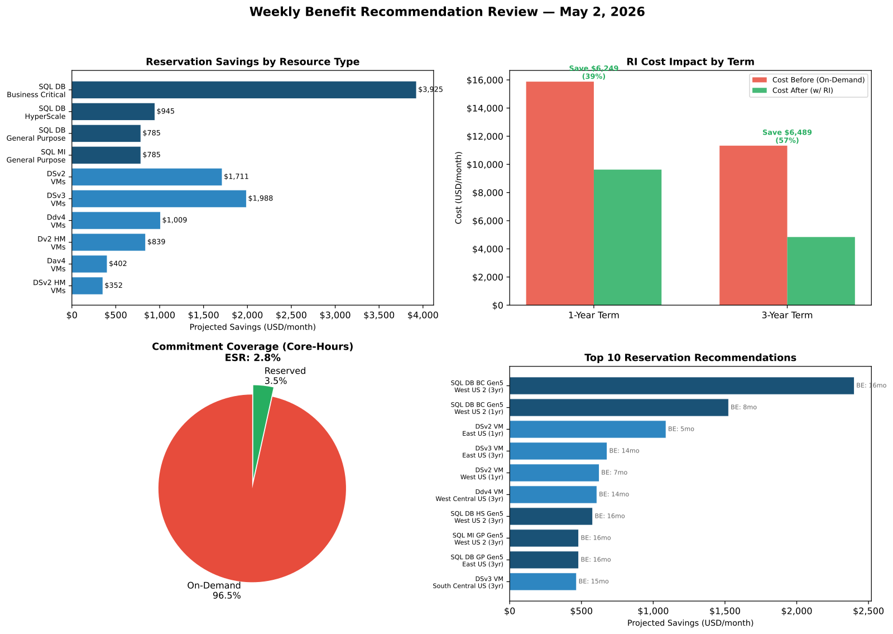
The answer
You sequence the decision: prove steady demand first, use RI for stable named SKUs, use SP for flexible compute, and use ODCR when supply guarantee is the blocker.
Real data: ESR is 2.81%, 96.5% of core-hours stay on-demand, and the review ranks 20 RI recommendations worth $12,739 per month.
Named tools: benefit-recommendations, commitment-discount-utilization, savings-summary-report, reservation-recommendation-breakdown.
🟡 Asks #17, #18
Notes:
Keep the answer concrete. The recommendation review and quarterly strategy run both show the same problem: the estate is heavily on-demand and under-committed. That is why the first move is not ODCR. It is disciplined commitment coverage on workloads that already look stable. Call out the anchor example: SQL DB BC Gen5 in West US 2 is the single largest savings item at about $2,400 per month on a 3-year term, with the 1-year option giving a faster break-even. Then add the yellow boundary: the agent can rank RI and SP with current evidence, but custom ODCR term modeling still belongs in the field and Azure commercial path.
Sources: MCAPS ask #17 — "RI vs SP vs ODCR positioning"; MCAPS ask #18 — "Commitment + capacity sequencing"
Canonical: memory://work/mcaps/mcaps-internal-asks-finops-toolkit-azure-capacity-ai-cost-may-2026
Coverage verdict per canonical: 🟡 partial
Evidence pack: src/templates/sre-agent/training/release-deck/evidence/tasks/benefit-recommendation-review.md
Chart proof: src/templates/sre-agent/training/release-deck/charts/svg/benefit-recommendation-charts.svg

Slide 13
The details
YAMLs: sre-config/scheduled-tasks/benefit-recommendation-review.yaml, cron 0 8 5; sre-config/scheduled-tasks/capacity-quarterly-strategy.yaml, cron 0 9 1 1,4,7,10 *.
Runtime: benefit-recommendations → reservation-recommendation-breakdown → commitment-discount-utilization → savings-summary-report.
Decision tree: if demand is stable for 12+ months, start with 1-year RI; if usage shifts across SKUs or regions, test SP; if supply is the blocker, pair the capacity motion separately and keep ODCR commercial terms outside the agent claim.
Monday move: srectl scheduledtask invoke benefit-recommendation-review
🟡 Asks #17, #18
Notes:
This is where you give the field a repeatable ordering rule. The weekly recommendation task ranks the savings path. The quarterly task checks whether that savings path actually fits the next-quarter capacity plan. That keeps the talk track from collapsing into "buy everything." Use the break-even numbers to keep the customer honest on stability. Use the on-demand percentage to show why action is needed. And keep one sentence reserved for the boundary: the deck can guide RI versus SP sequencing today, but it should not pretend to price custom ODCR structures. That clarity makes the yellow verdict a strength instead of a gap callout from the room.
Sources: MCAPS ask #17 — "RI vs SP vs ODCR positioning"; MCAPS ask #18 — "Commitment + capacity sequencing"
Canonical: memory://work/mcaps/mcaps-internal-asks-finops-toolkit-azure-capacity-ai-cost-may-2026
Coverage verdict per canonical: 🟡 partial
Evidence pack: src/templates/sre-agent/training/release-deck/evidence/tasks/benefit-recommendation-review.md
Chart proof: src/templates/sre-agent/training/release-deck/charts/svg/benefit-recommendation-charts.svg

Slide 14
The ask
“SGS capacity-blocked milestones.”
“Which milestone is blocked, and is MACC now at risk?”
🟢 Asks #15
Notes:
Make this one feel like a deal call, because that is how it arrives in the field. The customer does not ask for a quota lecture. The customer asks whether a milestone is going to slip and whether the commercial commitment is now in danger. Use that framing. Then pivot to the fact that this agent answers the capacity side of the question, not the whole SGS workflow. It checks whether compute headroom, storage headroom, CRG state, and regional readiness create the block. If those are healthy, you can say capacity is not the active blocker and let the field move to the next dependency with confidence.
Sources: MCAPS ask #15 — "SGS capacity-blocked milestones (MACC risk)"
Canonical: memory://work/mcaps/mcaps-internal-asks-finops-toolkit-azure-capacity-ai-cost-may-2026
Coverage verdict per canonical: 🟢 ships-today
Evidence pack: src/templates/sre-agent/training/release-deck/evidence/tasks/capacity-quarterly-strategy.md
Chart proof: src/templates/sre-agent/training/release-deck/charts/svg/quarterly-commitment-alignment.svg

Slide 15
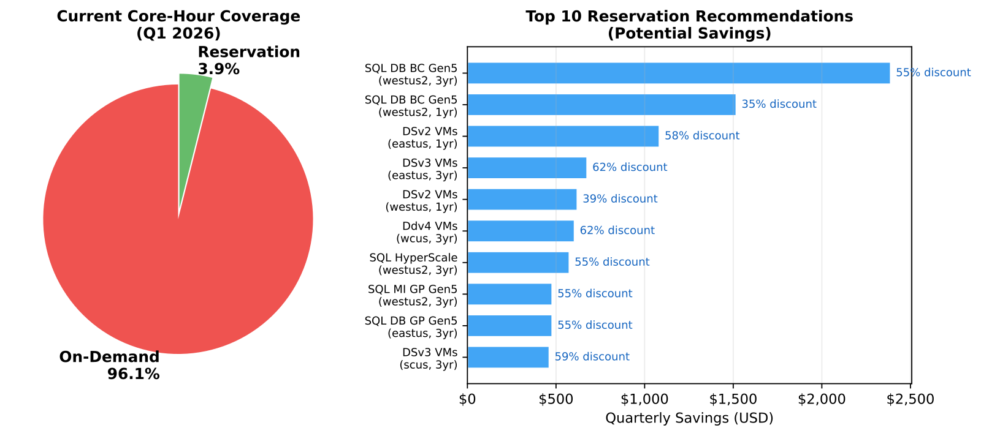
The answer
This estate shows no active capacity block: compute quota is 0%, storage peaks at 1.2%, and no CRG pressure appears in the quarterly review.
The quarterly strategy run gives a six-action roadmap, so you catch capacity risk before a milestone slips.
Named tools: vm-quota-usage, capacity-reservation-groups, resource-graph-query, cost-forecasting-model.
🟢 Asks #15
Notes:
Say the quiet part clearly: for this subscription, capacity is not the blocker right now. The quarterly review shows zero compute utilization and only 1.2 percent storage quota usage, so there is no current evidence that supply is what would hold an SGS milestone. That is the proof point the field needs in live deal reviews like the Celonis, Trimble, and Pure Storage patterns in the MCAPS threads. Then explain the positive use of the task: it is still valuable because it runs before the block happens. It gives a roadmap, checks the growth path, and lets you separate capacity risk from commercial or engineering risk early.
Sources: MCAPS ask #15 — "SGS capacity-blocked milestones (MACC risk)"
Canonical: memory://work/mcaps/mcaps-internal-asks-finops-toolkit-azure-capacity-ai-cost-may-2026
Coverage verdict per canonical: 🟢 ships-today
Evidence pack: src/templates/sre-agent/training/release-deck/evidence/tasks/capacity-quarterly-strategy.md
Chart proof: src/templates/sre-agent/training/release-deck/charts/svg/quarterly-commitment-alignment.svg

Slide 16
The details
YAML: sre-config/scheduled-tasks/capacity-quarterly-strategy.yaml, cron 0 9 1 1,4,7,10 *.
Runtime: vm-quota-usage → capacity-reservation-groups → resource-graph-query → cost-forecasting-model, then commitment checks for next-quarter risk.
Decision tree: if quota > 80% or a regional SKU blocks planned scale, treat it as a capacity risk; if all headroom is green, say capacity is not the current root cause and move the field to the next dependency.
Monday move: srectl scheduledtask invoke capacity-quarterly-strategy
🟢 Asks #15
Notes:
The tell slide gives the field a simple test. Run the quarterly strategy task when the account team says a milestone is at risk. If headroom is tight, you have evidence for a capacity action. If headroom is clean, you avoid wasting a week on the wrong escalation path. That matters because the commercial clock keeps running while teams argue about root cause. The runtime is already built to answer the operational part of the question: quota, reservations, resource inventory, and projected demand. Your speaker note should land on one message: this is the capacity triage lane for SGS risk, and it tells you quickly whether to escalate supply or move on.
Sources: MCAPS ask #15 — "SGS capacity-blocked milestones (MACC risk)"
Canonical: memory://work/mcaps/mcaps-internal-asks-finops-toolkit-azure-capacity-ai-cost-may-2026
Coverage verdict per canonical: 🟢 ships-today
Evidence pack: src/templates/sre-agent/training/release-deck/evidence/tasks/capacity-quarterly-strategy.md
Chart proof: src/templates/sre-agent/training/release-deck/charts/svg/quarterly-commitment-alignment.svg

Slide 17
The ask
“The customer refuses to change region.”
“What do you do when the required SKU is blocked where they insist on running?”
🟡 Asks #20
Notes:
Keep this one human and commercial. The room already knows that "pick another region" is the obvious answer. The problem is that the customer will not take it. So the field needs two things: proof that the issue is real, and a tighter set of alternatives than a hand wave. Your job is to show that the agent can separate offer restriction from capacity exhaustion and then give the field a factual negotiation position. The yellow verdict matters. The agent gives alternatives and evidence, but it does not close the commercial relocation conversation for the seller.
Sources: MCAPS ask #20 — "Customer refuses to change region"
Canonical: memory://work/mcaps/mcaps-internal-asks-finops-toolkit-azure-capacity-ai-cost-may-2026
Coverage verdict per canonical: 🟡 partial
Evidence pack: src/templates/sre-agent/training/release-deck/evidence/tasks/sku-availability-audit.md
Chart proof: src/templates/sre-agent/training/release-deck/charts/svg/adx-sku-availability.svg

Slide 18
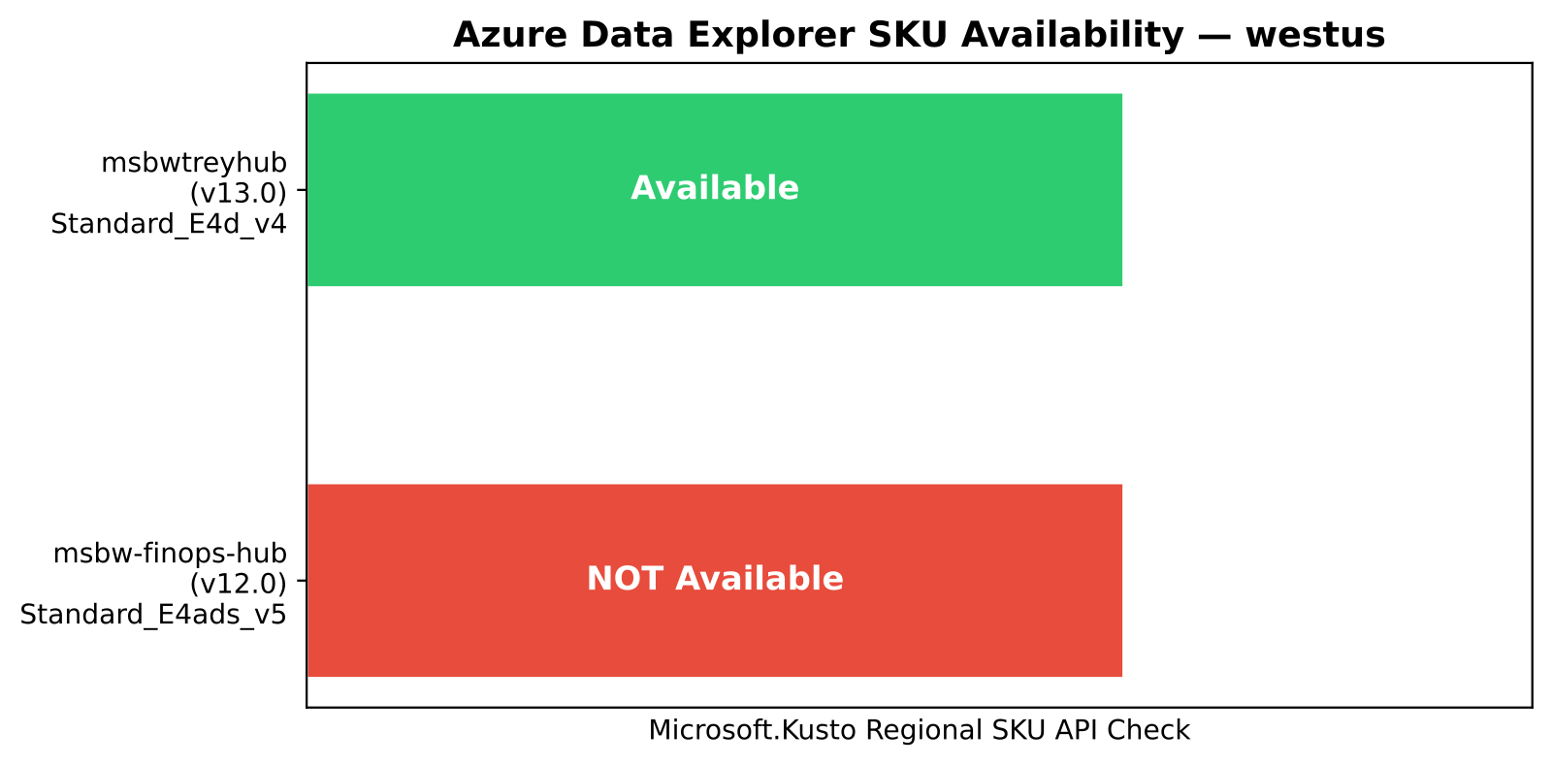
The answer
You answer with evidence, not opinion: westus shows 73 restricted SKUs out of 1,173, and the audit classifies the restrictions as offer-level availability, not quota exhaustion.
The ADX check also shows a real blocker: Standard_E4ads_v5 is unavailable in westus, while Standard_E4d_v4 is available as the migration target.
Named tools: sku-availability, vm-quota-usage, non-compute-quotas.
🟡 Asks #20
Notes:
Walk the field through the distinction that matters in negotiation. If the issue is quota, the customer can ask for more quota. If the issue is offer restriction or service-specific SKU unavailability, more quota does not fix it. That is why the audit checks both compute and Kusto-specific availability. Use westus as the anchor because the evidence is explicit there: 73 restricted SKUs, and the Kusto backend SKU used by the older hub path is not available for new provisioning. That gives the seller a factual alternative: keep the region if possible by changing SKU, and only then reopen the region conversation if the required service still does not fit.
Sources: MCAPS ask #20 — "Customer refuses to change region"
Canonical: memory://work/mcaps/mcaps-internal-asks-finops-toolkit-azure-capacity-ai-cost-may-2026
Coverage verdict per canonical: 🟡 partial
Evidence pack: src/templates/sre-agent/training/release-deck/evidence/tasks/sku-availability-audit.md
Chart proof: src/templates/sre-agent/training/release-deck/charts/svg/adx-sku-availability.svg

Slide 19
The details
YAML: sre-config/scheduled-tasks/sku-availability-audit.yaml, cron 0 7 3.
Runtime: sku-availability for compute, sku-availability with resource_provider: kusto for ADX, then vm-quota-usage and non-compute-quotas to rule out the wrong blocker.
Decision tree: if the SKU is unavailable, change SKU family first; if the SKU is available but quota is tight, plan quota work; if both fail, the field owns the region negotiation.
Monday move: srectl scheduledtask invoke sku-availability-audit
🟡 Asks #20
Notes:
The field needs a sequence, because "customer refuses to move" is not a technical diagnosis. Start by proving whether the region is blocked by SKU restriction or by quota. Then check whether a sibling SKU meets the same intent in the same region. The audit already does the service-specific Kusto check, which matters for hub and analytics backend conversations. Only after those two checks fail should the seller go back to the customer and reopen the region decision. That keeps the conversation factual and avoids the lazy answer of blaming capacity when the real issue is SKU eligibility or service shape.
Sources: MCAPS ask #20 — "Customer refuses to change region"
Canonical: memory://work/mcaps/mcaps-internal-asks-finops-toolkit-azure-capacity-ai-cost-may-2026
Coverage verdict per canonical: 🟡 partial
Evidence pack: src/templates/sre-agent/training/release-deck/evidence/tasks/sku-availability-audit.md
Chart proof: src/templates/sre-agent/training/release-deck/charts/svg/adx-sku-availability.svg

Slide 20
The ask
“AOAI quota vs GPU hardware capacity — why was the request denied?”
“AOAI PayGo to PTU transition timing + sizing.”
“Forecasting AI or token-based workloads.”
🟡 Asks #1, #2, #7
Notes:
Land the combined ask as three linked questions, because that is how they show up in the field. First, the customer wants to know whether the block is quota or hardware supply. Second, they want to know when PayGo stops making sense and PTU starts. Third, they need a forecast that is not based on VM instincts. The yellow verdict matters here. The agent gives strong token economics, workload concentration, and trend evidence. It does not replace Azure AI Foundry for GPU hardware capacity or PTU sizing authority. Say that early so the audience trusts everything that follows.
Sources: MCAPS ask #1 — "AOAI quota vs GPU hardware capacity — denied requests"; MCAPS ask #2 — "AOAI PayGo → PTU transition timing + sizing"; MCAPS ask #7 — "Forecasting AI / token-based workloads"
Canonical: memory://work/mcaps/mcaps-internal-asks-finops-toolkit-azure-capacity-ai-cost-may-2026
Coverage verdict per canonical: 🟡 partial
Evidence pack: src/templates/sre-agent/training/release-deck/evidence/tasks/ai-workload-cost-analysis.md
Chart proof: src/templates/sre-agent/training/release-deck/charts/svg/ai-daily-trend.svg

Slide 21
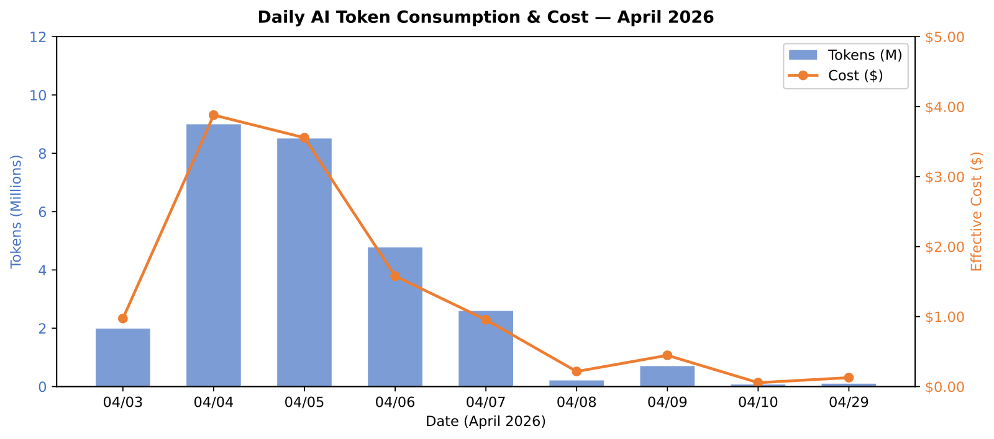
The answer
You answer the token side now: April 2026 shows 27.96M tokens for $11.82, GPT 5.2 drives 99.9% of spend, and the workload stays fully PayGo with no PTU commitment.
The cost pattern is dev-heavy, concentrated on one deployment, with a 162:1 input/output ratio that points to prompt optimization before commitment buying.
Named tools: ai-model-cost-comparison, ai-cost-by-application, resource-graph-query.
🟡 Asks #1, #2, #7
Notes:
This slide is the honest capacity lens for AI. The run proves that token forecasting and model mix are measurable today. It also proves that this tenant is nowhere near a PTU economic threshold yet, because the total monthly spend is only $11.82 and all usage sits on a single dev footprint. That means the immediate action is not a commitment purchase. It is usage hygiene and signal collection. Use the 162-to-1 ratio because it is memorable and it gives the room a concrete optimization lever. Then add the boundary sentence: GPU hardware capacity and final PTU sizing authority still sit in Azure AI Foundry, not in this report.
Sources: MCAPS ask #1 — "AOAI quota vs GPU hardware capacity — denied requests"; MCAPS ask #2 — "AOAI PayGo → PTU transition timing + sizing"; MCAPS ask #7 — "Forecasting AI / token-based workloads"
Canonical: memory://work/mcaps/mcaps-internal-asks-finops-toolkit-azure-capacity-ai-cost-may-2026
Coverage verdict per canonical: 🟡 partial
Evidence pack: src/templates/sre-agent/training/release-deck/evidence/tasks/ai-workload-cost-analysis.md
Chart proof: src/templates/sre-agent/training/release-deck/charts/svg/ai-daily-trend.svg

Slide 22
The details
YAML: sre-config/scheduled-tasks/ai-workload-cost-analysis.yaml, cron 0 10 1 .
Runtime: ai-token-usage-breakdown → ai-model-cost-comparison → ai-daily-trend → ai-cost-by-application → resource-graph-query, with vm-quota-usage used only for GPU-capable region checks.
Decision tree: if usage is low and dev-heavy, stay PayGo; if token demand becomes steady and large, escalate PTU sizing to Azure AI Foundry; if the customer asks whether the denial was GPU hardware or AOAI quota, treat that as a Foundry-owned capacity question.
Monday move: srectl scheduledtask invoke ai-workload-cost-analysis
🟡 Asks #1, #2, #7
Notes:
Use this slide to show the exact handoff line. The task already runs the token and allocation work in the right order, and it adds a GPU-region quota check when needed. That gives you a factual baseline for AI cost and workload shape. But do not let the room over-claim the result. The report can tell you whether the workload is steady enough to justify a PTU conversation. It cannot declare GPU hardware availability or close the quota-versus-capacity question at the service backend. That is why the yellow verdict is useful: the deck teaches the field what the agent does know and exactly when to bring Azure AI Foundry into the thread.
Sources: MCAPS ask #1 — "AOAI quota vs GPU hardware capacity — denied requests"; MCAPS ask #2 — "AOAI PayGo → PTU transition timing + sizing"; MCAPS ask #7 — "Forecasting AI / token-based workloads"
Canonical: memory://work/mcaps/mcaps-internal-asks-finops-toolkit-azure-capacity-ai-cost-may-2026
Coverage verdict per canonical: 🟡 partial
Evidence pack: src/templates/sre-agent/training/release-deck/evidence/tasks/ai-workload-cost-analysis.md
Chart proof: src/templates/sre-agent/training/release-deck/charts/svg/ai-daily-trend.svg

Slide 23
The ask
“AOAI PTU throttling confusion.”
“AOAI model availability by region.”
“AOAI production capacity GA expectations.”
“AOAI TPM/RPM tier behavior.”
🔴 Asks #3, #4, #5, #6
Notes:
Say up front that this is the honest red cluster. The field asks these questions constantly, and the worst possible deck move is pretending the SRE Agent answers them. It does not. Keep the ask slide raw and uncomfortable. Your audience needs to hear the exact questions because they are real, frequent, and tempting to answer with half-truths. Then promise the honest answer on the next slide: this agent gives adjacent evidence, but the live service facts sit with other owners. That honesty is the point of the slide, not an apology for missing scope.
Sources: MCAPS ask #3 — "AOAI PTU throttling confusion (TPM still applies)"; MCAPS ask #4 — "AOAI model availability by region"; MCAPS ask #5 — "AOAI production capacity GA expectations"; MCAPS ask #6 — "AOAI TPM/RPM tier behavior"
Canonical: memory://work/mcaps/mcaps-internal-asks-finops-toolkit-azure-capacity-ai-cost-may-2026
Coverage verdict per canonical: 🔴 out-of-scope
Evidence pack: None — honest boundary slide
Chart proof: None

Slide 24
The answer
This agent gives token cost, model mix, and Azure resource inventory. It does not give live AOAI throttling telemetry, model-by-region GA inventory, or GA roadmap commitments.
Azure AI Foundry PG owns model availability and throttling metrics. The Azure AI capacity team owns production-capacity GA timing.
Your answer is the boundary statement, not a fake chart.
🔴 Asks #3, #4, #5, #6
Notes:
Deliver this slide with confidence, not hesitation. You are not saying "nothing is available." You are saying the available evidence is different: token economics, workload concentration, model mix, and surrounding Azure resource inventory. Those are useful inputs, but they do not answer live throttling mechanics or regional GA status. Name the actual owners clearly so the field has a path forward. This is what honest enablement looks like: you give the seller a crisp boundary statement, you stop bad promises before they happen, and you direct the escalation to the team that actually publishes those service facts.
Sources: MCAPS ask #3 — "AOAI PTU throttling confusion (TPM still applies)"; MCAPS ask #4 — "AOAI model availability by region"; MCAPS ask #5 — "AOAI production capacity GA expectations"; MCAPS ask #6 — "AOAI TPM/RPM tier behavior"
Canonical: memory://work/mcaps/mcaps-internal-asks-finops-toolkit-azure-capacity-ai-cost-may-2026
Coverage verdict per canonical: 🔴 out-of-scope
Evidence pack: None — honest boundary slide
Chart proof: None

Slide 25
The details
Boundary owner: Azure AI Foundry PG for model availability and throttling metrics; Azure AI capacity team for GA roadmap and service-capacity timing.
Do not claim live PTU throttle diagnosis, region-by-model GA guarantees, or TPM/RPM semantics from this agent or this deck.
Monday move: route the customer question with tenant, region, model, TPM/RPM, and timestamp to the actual owner path.
🔴 Asks #3, #4, #5, #6
Notes:
Use the tell slide to make the escalation reproducible. If the customer asks about throttling, capture the model, region, tier, timestamp, and observed behavior. If the customer asks about GA timing, route it to the capacity owner and keep the deck out of the promise chain. If the customer asks which models are live in region, point them to the Azure AI Foundry source of truth instead of summarizing from memory. This slide protects the field from accidental overstatement. It also protects the training deck, because once you make one unsupported service claim in the room, every grounded part of the deck loses credibility with the audience.
Sources: MCAPS ask #3 — "AOAI PTU throttling confusion (TPM still applies)"; MCAPS ask #4 — "AOAI model availability by region"; MCAPS ask #5 — "AOAI production capacity GA expectations"; MCAPS ask #6 — "AOAI TPM/RPM tier behavior"
Canonical: memory://work/mcaps/mcaps-internal-asks-finops-toolkit-azure-capacity-ai-cost-may-2026
Coverage verdict per canonical: 🔴 out-of-scope
Evidence pack: None — honest boundary slide
Chart proof: None

Slide 26
The ask
“Show me that the MACC discount is actually burning the way finance expects.”
CFO / finance buyer
🟢 Asks #35
Notes:
You read this ask as a finance-control question, not a tooling question. The customer wants proof that Azure cost already reflects negotiated economics. This slide sets up the right answer: not contract ingestion, but list-cost versus effective-cost verification on a fixed cadence. That keeps the motion honest. You do not claim direct MACC contract reads. You show recurring evidence that discounts land in the estate and that finance can inspect the gap every Monday.
Sources: MCAPS ask #35 — "CFO / finance buyer: CFO: MACC discount verification"
Canonical: memory://work/mcaps/mcaps-internal-asks-finops-toolkit-azure-capacity-ai-cost-may-2026
Coverage verdict per canonical: 🟢 ships-today
Evidence pack: src/templates/sre-agent/training/release-deck/evidence/tasks/cost-optimization.md
Chart proof: src/templates/sre-agent/training/release-deck/charts/svg/chart-commitment-savings.svg

Slide 27
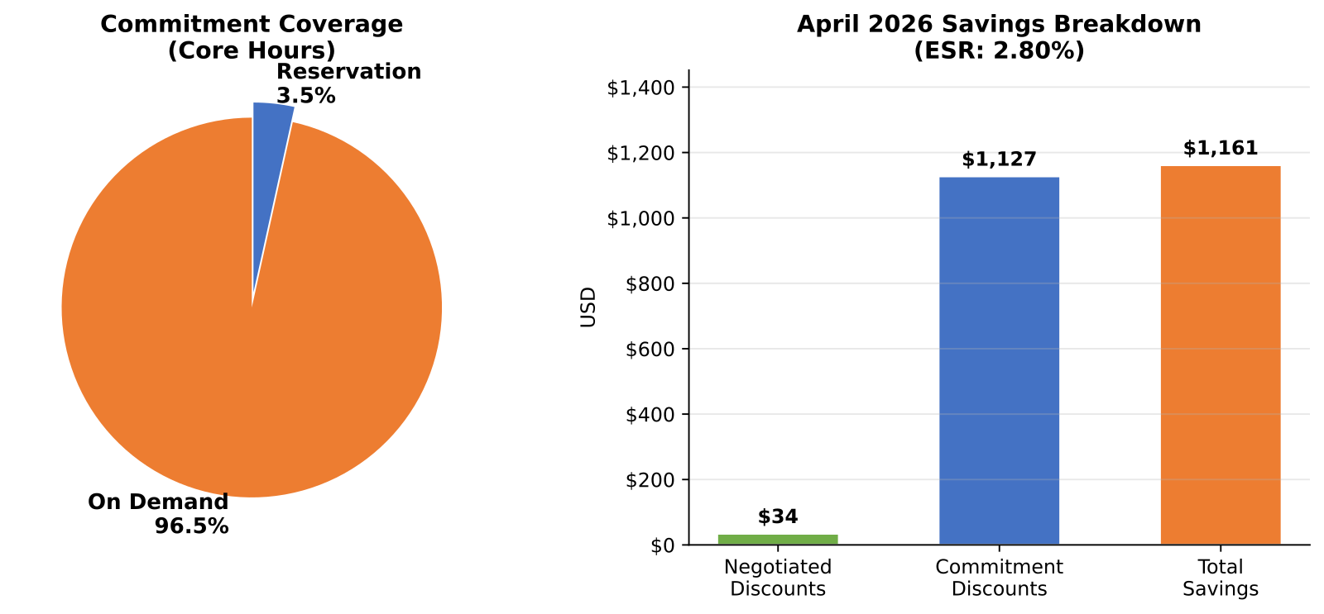
The answer
You verify discount burn by comparing list cost, effective cost, and savings in one weekly card.
savings-summary-report, commitment-discount-utilization, benefit-recommendations, and cost-optimization show $41,473 list cost, $40,306 effective cost, ESR 2.81%, $34 negotiated discount savings, and $1,127 commitment savings.
That list-to-effective gap gives finance a fresh Monday check that discounts apply correctly.
🟢 Asks #35
Notes:
You answer the ask with finance math. The weekly evidence pack shows $41,473 at list, about $40.3K effective, and savings broken into $34 negotiated discounts plus $1,127 commitment discounts. A CFO can read that split and verify that discount mechanics are hitting the bill. The honest line matters: this is not MACC contract metadata. It is operational verification from FinOps Hub data. For finance buyers, that is often enough to validate that Azure is burning correctly before anyone starts a separate contract reconciliation thread.
Sources: MCAPS ask #35 — "CFO / finance buyer: CFO: MACC discount verification"
Canonical: memory://work/mcaps/mcaps-internal-asks-finops-toolkit-azure-capacity-ai-cost-may-2026
Coverage verdict per canonical: 🟢 ships-today
Evidence pack: src/templates/sre-agent/training/release-deck/evidence/tasks/cost-optimization.md
Chart proof: src/templates/sre-agent/training/release-deck/charts/svg/chart-commitment-savings.svg

Slide 28
The details
Task YAML: sre-config/scheduled-tasks/cost-optimization.yaml
Cron: 0 8 1
KQL / tool spine: savings-summary-report + commitment-discount-utilization + benefit-recommendations + cost-optimization tools
Monday move: srectl scheduledtask invoke cost-optimization
🟢 Asks #35
Notes:
You land the L400 point here. The answer is a scheduled finance check, not an analyst fire drill. cost-optimization.yaml runs every Monday at 08:00 UTC and posts the same comparison structure each week. The named tools are the proof chain: savings summary, commitment utilization, benefit recommendations, and the broader cost-optimization pass. That means the field can turn a skeptical MACC question into a standing review motion. On Monday, run the task, open the card with finance, and inspect the list-versus-effective gap together.
Sources: MCAPS ask #35 — "CFO / finance buyer: CFO: MACC discount verification"
Canonical: memory://work/mcaps/mcaps-internal-asks-finops-toolkit-azure-capacity-ai-cost-may-2026
Coverage verdict per canonical: 🟢 ships-today
Evidence pack: src/templates/sre-agent/training/release-deck/evidence/tasks/cost-optimization.md
Chart proof: src/templates/sre-agent/training/release-deck/charts/svg/chart-commitment-savings.svg

Slide 29
The ask
“Why do I still pay CloudHealth, Apptio, Vantage, or Spot if Azure already has the data?”
CFO / procurement lens
🟢 Asks #47
Notes:
You read this as a positioning ask from finance, procurement, or an account team under competitive pressure. The customer does not need a feature grid first. The customer needs a crisp statement of what the in-estate operating model replaces. This ask sets up that distinction. You are not claiming one-for-one parity across every workflow. You are showing that the hub plus the agent gives recurring visibility, recurring analysis, and recurring Teams delivery that buyers often fund through separate dashboard licenses and consulting cycles.
Sources: MCAPS ask #47 — "Competitive / native gaps: Vendor displacement: CloudHealth / Apptio / Vantage / Spot"
Canonical: memory://work/mcaps/mcaps-internal-asks-finops-toolkit-azure-capacity-ai-cost-may-2026
Coverage verdict per canonical: 🟢 ships-today
Evidence pack: src/templates/sre-agent/training/release-deck/evidence/tasks/cost-optimization.md
Chart proof: src/templates/sre-agent/training/release-deck/charts/svg/chart-top-services.svg

Slide 30
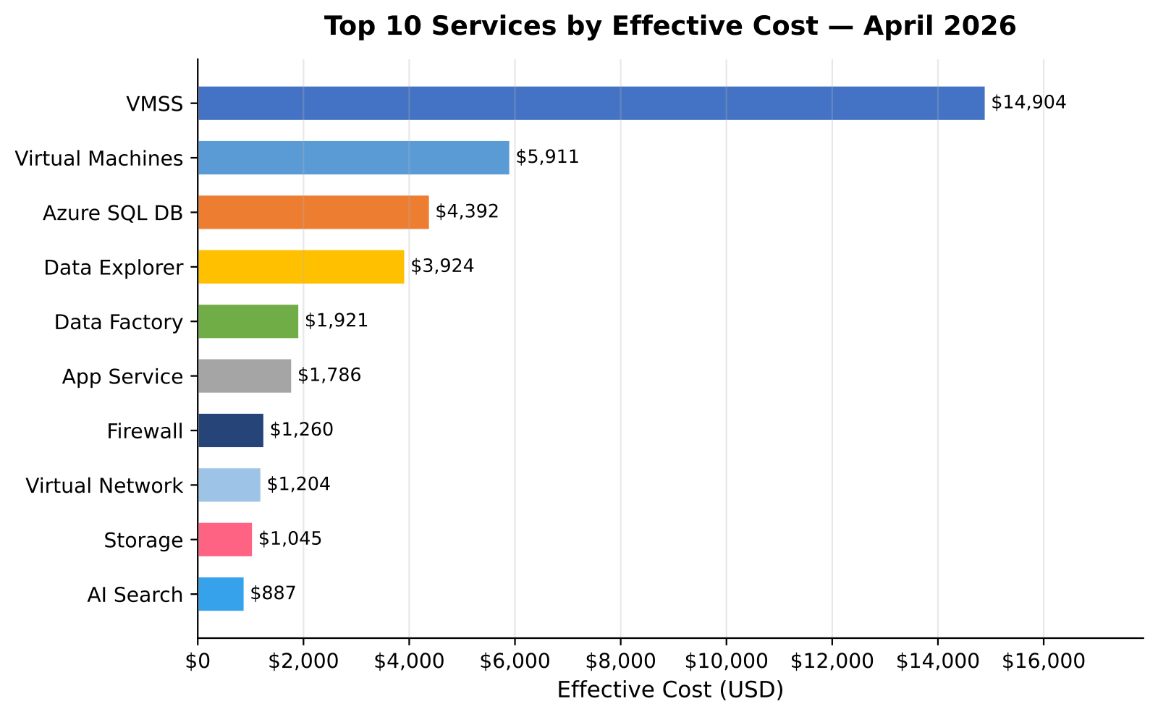
The answer
You replace licensed dashboard review cycles with an in-estate operating rhythm.
chart-top-services.svg shows the executive cost visibility buyers expect, while the FinOps toolkit SRE Agent adds 18 scheduled tasks, 5 subagents, 3 skills, 33 tools, and Teams delivery inside the customer estate.
The finance story is continuous analysis and action, not another annual dashboard contract.
🟢 Asks #47
Notes:
This is a positioning slide, not a battlecard. You keep it honest and simple. CloudHealth, Apptio, Vantage, and Spot each sell dashboards, optimization views, or managed review motions. The SRE Agent shows the same cost-driver visibility and then keeps going: 18 scheduled tasks, named tools, and Teams cards on a recurring cadence. That matters to a CFO because the question is not only “can I see the spend?” but also “who reads it every week and what happens next?” The answer here is a native Azure and FinOps hub rhythm, not a static annual review.
Sources: MCAPS ask #47 — "Competitive / native gaps: Vendor displacement: CloudHealth / Apptio / Vantage / Spot"
Canonical: memory://work/mcaps/mcaps-internal-asks-finops-toolkit-azure-capacity-ai-cost-may-2026
Coverage verdict per canonical: 🟢 ships-today
Evidence pack: src/templates/sre-agent/training/release-deck/evidence/tasks/cost-optimization.md
Chart proof: src/templates/sre-agent/training/release-deck/charts/svg/chart-top-services.svg

Slide 31
The details
Operating catalog: src/templates/sre-agent/CATALOG.md
Runtime footprint: 18 scheduled tasks, 5 subagents, 3 skills, 33 tools, Teams delivery via PostTeamsMessage
Example YAML: sre-config/scheduled-tasks/cost-optimization.yaml on 0 8 1
Monday move: run one scheduled task live and compare the Teams card to the vendor quote
🟢 Asks #47
Notes:
You make the replacement concrete with the catalog. The catalog is the operating model. It shows daily, weekly, monthly, and quarterly motion, not a one-time consultant deliverable. For the field, the fastest proof is simple: pick one task, run it, and show the card in Teams. That demonstrates cadence, delivery, and follow-through in minutes. Keep the claim tight: this deck does not score every competitor feature. It shows that the customer already has a working finance-and-operations rhythm inside Azure instead of paying only for external reporting surfaces.
Sources: MCAPS ask #47 — "Competitive / native gaps: Vendor displacement: CloudHealth / Apptio / Vantage / Spot"
Canonical: memory://work/mcaps/mcaps-internal-asks-finops-toolkit-azure-capacity-ai-cost-may-2026
Coverage verdict per canonical: 🟢 ships-today
Evidence pack: src/templates/sre-agent/training/release-deck/evidence/tasks/cost-optimization.md
Chart proof: src/templates/sre-agent/training/release-deck/charts/svg/chart-top-services.svg

Slide 32
The ask
“Azure Gov or regulated cloud private endpoints.”
“Gov or DoD support boundary clarity.”
🟡 Asks #60, #72
Notes:
Treat this as a boundary conversation first, not a feature pitch. The field wants to know whether the deck can safely claim sovereign support and whether private endpoint expectations carry over. The right answer is mixed. The agent is validated in standard regions, and the field can use regional restriction data there. But Gov and DoD support claims are a separate bar. Say that plainly. The worst move here is to let standard-region evidence imply sovereign validation that the repo does not claim. Keep the ask slide sparse so the room hears the support-boundary question without distraction.
Sources: MCAPS ask #60 — "Azure Gov / regulated cloud private endpoints"; MCAPS ask #72 — "Gov / DoD support boundary clarity"
Canonical: memory://work/mcaps/mcaps-internal-asks-finops-toolkit-azure-capacity-ai-cost-may-2026
Coverage verdict per canonical: 🟡 partial
Evidence pack: src/templates/sre-agent/training/release-deck/evidence/tasks/sku-availability-audit.md
Chart proof: src/templates/sre-agent/training/release-deck/charts/svg/sku-restrictions-by-region.svg

Slide 33
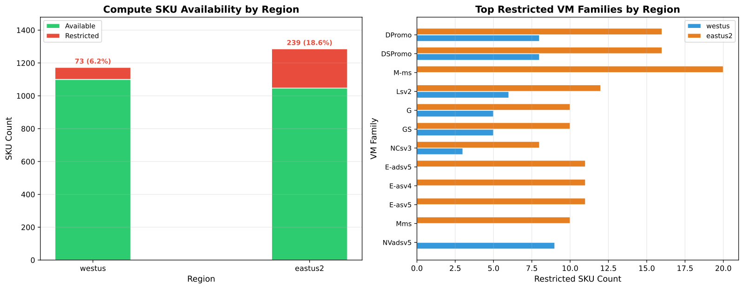
The answer
You can say what is validated today: standard-region support is eastus2, swedencentral, and australiaeast, and the agent can show regional SKU restriction patterns there.
You cannot claim Azure Gov or DoD validation from this deck, and private endpoints still depend on the target ADX cluster networking configuration.
Named tools: sku-availability, standard regions only.
🟡 Asks #60, #72
Notes:
Keep the answer narrow and defensible. The repo guidance is explicit on supported standard regions, so use that with confidence. Then separate the sovereign question: Gov and DoD are not validated here, and the deck should not imply they are. The regional restrictions chart is still useful because it teaches the field what kind of evidence the agent can gather in validated environments. But it is a pattern chart, not a sovereign attestation. End by calling out private endpoints specifically: that is a deployment and networking check on the actual ADX or analytics backend, not a blanket property you can promise across clouds or support boundaries.
Sources: MCAPS ask #60 — "Azure Gov / regulated cloud private endpoints"; MCAPS ask #72 — "Gov / DoD support boundary clarity"
Canonical: memory://work/mcaps/mcaps-internal-asks-finops-toolkit-azure-capacity-ai-cost-may-2026
Coverage verdict per canonical: 🟡 partial
Evidence pack: src/templates/sre-agent/training/release-deck/evidence/tasks/sku-availability-audit.md
Chart proof: src/templates/sre-agent/training/release-deck/charts/svg/sku-restrictions-by-region.svg

Slide 34
The details
Supported standard regions in repo guidance: eastus2, swedencentral, australiaeast.
Decision tree: if the ask is standard-region readiness, run sku-availability and show regional restriction evidence; if the ask is Gov or DoD support, use a boundary statement and move to the validated owner path.
Private endpoint answer: check the target analytics backend networking configuration before you promise anything.
Monday move: None — honest boundary statement, not a scheduled-task claim.
🟡 Asks #60, #72
Notes:
Use this slide to keep the field from overextending standard-region proof into sovereign claims. The technical detail is simple: this deck can point to supported standard regions and show how regional restriction evidence works there. It cannot certify Gov or DoD deployment posture. That distinction matters because the audience will often hear one as the other if you rush the answer. Keep the private-endpoint statement equally disciplined. It depends on the actual backend networking model in the target environment, so treat it as a validation item, not a canned promise. This is a yellow cluster because you do have grounded standard-region evidence, but you stop short of unsupported sovereign claims.
Sources: MCAPS ask #60 — "Azure Gov / regulated cloud private endpoints"; MCAPS ask #72 — "Gov / DoD support boundary clarity"
Canonical: memory://work/mcaps/mcaps-internal-asks-finops-toolkit-azure-capacity-ai-cost-may-2026
Coverage verdict per canonical: 🟡 partial
Evidence pack: src/templates/sre-agent/training/release-deck/evidence/tasks/sku-availability-audit.md
Chart proof: src/templates/sre-agent/training/release-deck/charts/svg/sku-restrictions-by-region.svg

Slide 35
The ask
“&gt; "We are moving from EA to MCA."”
“&gt; "How do I know the Hub still matches the bill?"”
“&gt; "I cannot lose finance trust on day one."”
🟡 Asks #52
Notes:
Open with the trust problem, not the migration mechanics. Your customer is asking whether the cost data still holds after the commerce cutover and whether finance can keep using the Hub the next morning. Keep the slide sparse and let the quote breathe. The next two slides show the honest answer: you can run a fast post-migration health verdict with real freshness and scope checks, but you do not get a preventive migration shield from this release.
Sources: MCAPS ask #52 — "EA → MCA migration safety with FTK"
Canonical: memory://work/mcaps/mcaps-internal-asks-finops-toolkit-azure-capacity-ai-cost-may-2026
Coverage verdict per canonical: 🟢 ships-today | 🟡 partial | 🔴 out-of-scope
Evidence pack: src/templates/sre-agent/training/release-deck/evidence/tasks/hubs-health-check.md
Chart proof: src/templates/sre-agent/training/release-deck/charts/svg/data-freshness.svg

Slide 36
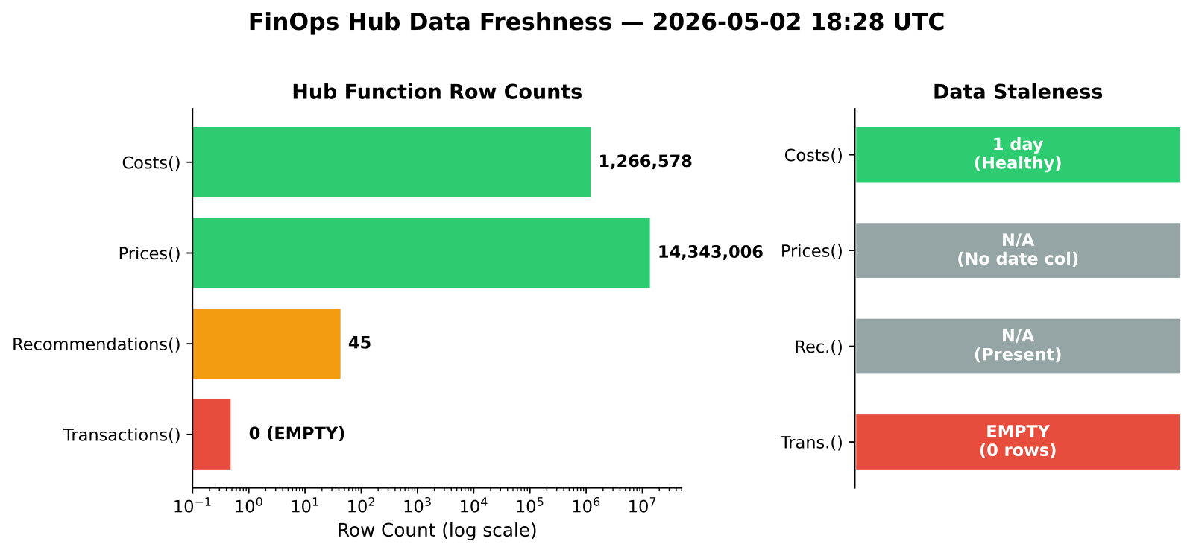
The answer
You run hubs-health-check and data-freshness-check after the cutover, then compare scope with monitoring-scope-validation.
The real run shows Costs() at 1,266,578 rows with 1 day staleness, Prices() at 14,343,006 rows, Recommendations() present, and Transactions() at 0 rows.
The same evidence shows 24 subscriptions monitored, 2,332 rows with empty SubAccountId, and hub version 13.0 behind 14.0.
That is a safety verdict you can hand to finance in minutes, not a guarantee that migration-side problems never happen.
🟡 Asks #52
Notes:
Point at the chart and read the numbers. The answer is yellow because the agent tells you whether the Hub stayed healthy after the commerce change, whether the data is fresh, and whether subscription coverage still looks credible. It does not stop an EA to MCA migration from introducing export or billing-scope issues upstream. That honesty matters. Your field move is to use the health check as the first post-cutover proof pack, then escalate any empty Transactions() or scope drift before finance starts reconciling in spreadsheets.
Sources: MCAPS ask #52 — "EA → MCA migration safety with FTK"
Canonical: memory://work/mcaps/mcaps-internal-asks-finops-toolkit-azure-capacity-ai-cost-may-2026
Coverage verdict per canonical: 🟢 ships-today | 🟡 partial | 🔴 out-of-scope
Evidence pack: src/templates/sre-agent/training/release-deck/evidence/tasks/monitoring-scope-validation.md
Chart proof: src/templates/sre-agent/training/release-deck/charts/svg/data-freshness.svg

Slide 37
The details
hubs-health-check.yaml — cron 0 6 *.
monitoring-scope-validation.yaml — cron 0 9 4.
Checks: Costs(), Prices(), Recommendations(), Transactions(), hub version, subscription count, and empty SubAccountId rows.
Decision line: healthy freshness + expected scope = finance can keep reading; empty Transactions() or scope drift = investigate exports before reconciliation.
Monday move: srectl scheduledtask invoke hubs-health-check.
🟡 Asks #52
Notes:
This is the L400 operator view. Show that the answer is not a vague health badge. It is a scheduled task pair with named functions and a concrete decision path. Your customer can run the daily health check and the weekly scope validation against the same Hub and turn a migration scare into a governed checklist: freshness, function coverage, version, and subscription scope. Keep the yellow verdict on screen. The release gives a trust-verification motion after the migration event, not a commerce-side migration control plane.
Sources: MCAPS ask #52 — "EA → MCA migration safety with FTK"
Canonical: memory://work/mcaps/mcaps-internal-asks-finops-toolkit-azure-capacity-ai-cost-may-2026
Coverage verdict per canonical: 🟢 ships-today | 🟡 partial | 🔴 out-of-scope
Evidence pack: src/templates/sre-agent/training/release-deck/evidence/tasks/hubs-health-check.md
Chart proof: src/templates/sre-agent/training/release-deck/charts/svg/data-freshness.svg

Slide 38
What you've heard / what's next
You heard 11 deal motions: quota is not capacity, CRG cost, RI and SP sequencing, SGS milestone risk, region lock, AOAI quota and GPU forecasting, AOAI honest scope, MACC verification, vendor displacement, sovereign scope, and EA to MCA safety.
Part 2 shifts from deal-entry asks to operating rhythm: token attribution, finance reconciliation, Teams cadence, FinOps Framework mapping, and the run-it-for-them schedule.
Use Part 1 to open the meeting. Use Part 2 to show the system.
Notes:
You close Part 1 by naming the pattern. Every ask mapped to a named task, a named tool chain, and an honest scope line. That is why the first half of the deck works in field conversations: it sounds like the customer, then it answers with evidence instead of theory. The second half now moves from deal-entry motions to operational proof. Tomorrow or in the next session, the audience sees the cadence: AI economics, reconciliation, Teams delivery, and the schedule that keeps running after deployment.
Sources: MCAPS asks #1,#2,#3,#4,#5,#6,#7,#15,#17,#18,#20,#35,#47,#52,#60,#72 — "Part 1 recap across 11 deal-motion clusters"
Canonical: memory://work/mcaps/mcaps-internal-asks-finops-toolkit-azure-capacity-ai-cost-may-2026
Coverage verdict per canonical: 🟢 ships-today
Evidence pack: src/templates/sre-agent/training/release-deck/evidence/tasks/cost-optimization.md
Chart proof: src/templates/sre-agent/training/release-deck/charts/svg/chart-commitment-savings.svg

Slide 39
FinOps toolkit SRE Agent — Part 2 of 2
After signature, you run the shop — cost, capacity, cadence, and credibility.
FinOps Toolkit community in MCAPS, worldwide.
Built by FinOps Toolkit
In partnership with Azure SRE Agent product team.
Notes:
Recap Part 1 in one sentence: before signature, you defend and expand the deal. Then shift the room to the operate motion: after signature, your customer needs a repeatable shop rhythm for AI cost ops, reconciliation, allocation, daily and weekly briefings, quarterly decisions, and honest support boundaries. Set expectation that Part 2 is not another dashboard tour. It is a runbook built from scheduled tasks, Teams delivery, and named tools that already ran in the evidence pack.
Sources: MCAPS asks #21, #24, #25, #36, #41, #43, #48, #49 — "Operate motion — after signature, run the shop"
Canonical: memory://work/mcaps/mcaps-internal-asks-finops-toolkit-azure-capacity-ai-cost-may-2026
Coverage verdict per canonical: 🟢 ships-today | 🟡 partial | 🔴 out-of-scope
Evidence pack: src/templates/sre-agent/training/release-deck/deck-outline-v8.md
Chart proof: None

Slide 40
What Part 2 covers
P2.1 Capacity rhythm; P2.2 AOAI token attribution; P2.3 AI budget brake pedal.
P2.4 AI model substitution + prompt economics; P2.5 daily cost-mover briefing; P2.6 anomaly detection chain.
P2.7 CFO reconciliation trust gap; P2.8 hub freshness verdicts; P2.9 RI/SP math + portal reconciliation.
P2.10 Allocation hygiene + post-M&A; P2.11 FinOps Framework operationalization; P2.12 Dashboard adoption → Teams cadence.
P2.13 Native CM gaps; P2.14 Run-it-for-them ops model; P2.15 FTK supportability — honest.
Notes:
Walk the audience through the map once so they know the rhythm. These 15 clusters move from daily operating signals to weekly and monthly finance actions, then into quarterly governance and honest support scope. Tell the field exactly what to listen for: where the agent gives a green answer today, where the answer is yellow and needs tags, exports, or process, and where the right owner is outside this release. That framing makes the honest slides land as credibility, not as a retreat.
Sources: MCAPS asks #21, #24, #25, #27, #36, #41, #43, #48, #49 — "Operate motion themes across cadence, AI cost, reconciliation, allocation, and supportability"
Canonical: memory://work/mcaps/mcaps-internal-asks-finops-toolkit-azure-capacity-ai-cost-may-2026
Coverage verdict per canonical: 🟢 ships-today | 🟡 partial | 🔴 out-of-scope
Evidence pack: src/templates/sre-agent/training/release-deck/deck-outline-v8.md
Chart proof: None

Slide 41
The ask
“Supply chain forecast depth — 30, 60, 90, 180 days?”
“Proactive capacity monitoring.”
“Do you find the problem before deployment fails?”
🟢 Asks #21, #24
Notes:
Frame this as an operating cadence question, because that is what the field needs to sell. Your customer is not buying a single report. Your customer is buying a rhythm that checks the estate before capacity turns into a blocker. Keep the ask slide light and temporal: how far out can you see, and how often do you check. Then use the next slide to show that the answer is not theoretical. There is a daily monitor, a Monday supply review, a first-of-month planning cycle, and a quarterly strategy pass. That is the green story: repeatable rhythm with named tasks and real runs.
Sources: MCAPS ask #21 — "Supply chain forecast depth (30/60/90/180 days?)"; MCAPS ask #24 — "Proactive capacity monitoring (no real-time API)"
Canonical: memory://work/mcaps/mcaps-internal-asks-finops-toolkit-azure-capacity-ai-cost-may-2026
Coverage verdict per canonical: 🟢 ships-today
Evidence pack: src/templates/sre-agent/training/release-deck/evidence/tasks/capacity-weekly-supply-review.md
Chart proof: src/templates/sre-agent/training/release-deck/charts/svg/chart4-commitment-monthly.svg

Slide 42
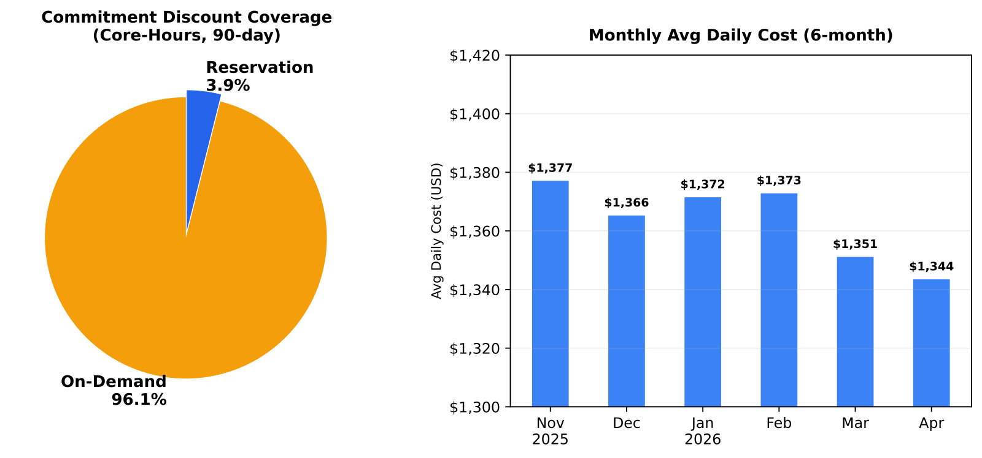
The answer
You answer with a cadence, not a one-off check: daily monitor at 06:30 UTC, weekly supply review on Monday at 08:00 UTC, monthly planning on day 1, and quarterly strategy on quarter start.
The rhythm covers 30, 60, 90, and 180-day horizons, and the weekly run scans 49 regions in one pass.
Named tools: vm-quota-usage, non-compute-quotas, sku-availability, capacity-reservation-groups, benefit-recommendations, data-freshness-check.
🟢 Asks #21, #24
Notes:
Deliver this slide like a heartbeat. Daily tells you whether anything is broken now. Weekly tells you whether headroom, SKU state, or CRG posture is drifting. Monthly tells you what demand and procurement look like next. Quarterly tells you whether the whole supply chain is maturing. That is the reason the green verdict matters: the field can point to a real cadence with real evidence. Use the 49-region scan because it makes the scale concrete. And use the horizon language carefully: 30 and 60 days come from the recommendation lookbacks, 90 days from forecast and next-quarter planning, and 180 days from the monthly planning history baseline.
Sources: MCAPS ask #21 — "Supply chain forecast depth (30/60/90/180 days?)"; MCAPS ask #24 — "Proactive capacity monitoring (no real-time API)"
Canonical: memory://work/mcaps/mcaps-internal-asks-finops-toolkit-azure-capacity-ai-cost-may-2026
Coverage verdict per canonical: 🟢 ships-today
Evidence pack: src/templates/sre-agent/training/release-deck/evidence/tasks/capacity-weekly-supply-review.md
Chart proof: src/templates/sre-agent/training/release-deck/charts/svg/chart4-commitment-monthly.svg

Slide 43
The details
YAMLs: sre-config/scheduled-tasks/capacity-daily-monitor.yaml, 30 6 ; capacity-weekly-supply-review.yaml, 0 8 1; capacity-monthly-planning.yaml, 0 9 1 ; capacity-quarterly-strategy.yaml, 0 9 1 1,4,7,10 .
Runtime chain: daily health → weekly supply review → monthly plan → quarterly strategy, with KQL and Python tools carrying forward quota, CRG, SKU, benefit, and freshness evidence.
Decision tree: if daily is red, fix now; if weekly shows drift, plan procurement; if monthly shows growth, schedule action; if quarterly shows maturity gaps, change the program.
Monday move: srectl scheduledtask invoke capacity-daily-monitor
🟢 Asks #21, #24
Notes:
The tell slide should make the rhythm operational for the room. Start with the daily check because it feeds the rest of the cadence. If the daily run shows healthy state, the weekly run adds breadth across regions and quotas. The monthly run adds history and forecast. The quarterly run adds strategy and maturity scoring. That is the full supply-chain motion from monitor to forecast. Use the exact cron strings because L400 listeners will ask. And end on the decision tree because that is what the field can reuse on Monday morning: red means respond now, yellow means plan, green means keep the rhythm and let the next layer do its job.
Sources: MCAPS ask #21 — "Supply chain forecast depth (30/60/90/180 days?)"; MCAPS ask #24 — "Proactive capacity monitoring (no real-time API)"
Canonical: memory://work/mcaps/mcaps-internal-asks-finops-toolkit-azure-capacity-ai-cost-may-2026
Coverage verdict per canonical: 🟢 ships-today
Evidence pack: src/templates/sre-agent/training/release-deck/evidence/tasks/capacity-weekly-supply-review.md
Chart proof: src/templates/sre-agent/training/release-deck/charts/svg/chart4-commitment-monthly.svg

Slide 44
The ask
“Show me who is burning AOAI tokens, what that means in dollars, and whether I can see it before month-end.”
Finance and AI workload owner
🟡 Asks #25, #26, #28
Notes:
This cluster combines three finance asks into one reading path. The customer wants attribution, dollar translation, and faster visibility. You answer the first two directly and keep the third honest. The deck should sound like finance, not model hype. Token volume only matters when it maps cleanly to dollars, models, and applications. This ask slide gives you permission to say that the packaged evidence already translates tokens to cost and usage mix, while near-real-time observability still depends on a broader telemetry stack than this release pack includes.
Sources: MCAPS asks #25,#26,#28 — "AI cost / FinOps maturity: AOAI token attribution per user / app / team"; "AI cost / FinOps maturity: Token → dollar translation + reconciliation"; "AI cost / FinOps maturity: Near-real-time AI cost observability"
Canonical: memory://work/mcaps/mcaps-internal-asks-finops-toolkit-azure-capacity-ai-cost-may-2026
Coverage verdict per canonical: 🟡 partial
Evidence pack: src/templates/sre-agent/training/release-deck/evidence/tasks/ai-workload-cost-analysis.md
Chart proof: src/templates/sre-agent/training/release-deck/charts/svg/ai-mom-comparison.svg

Slide 45
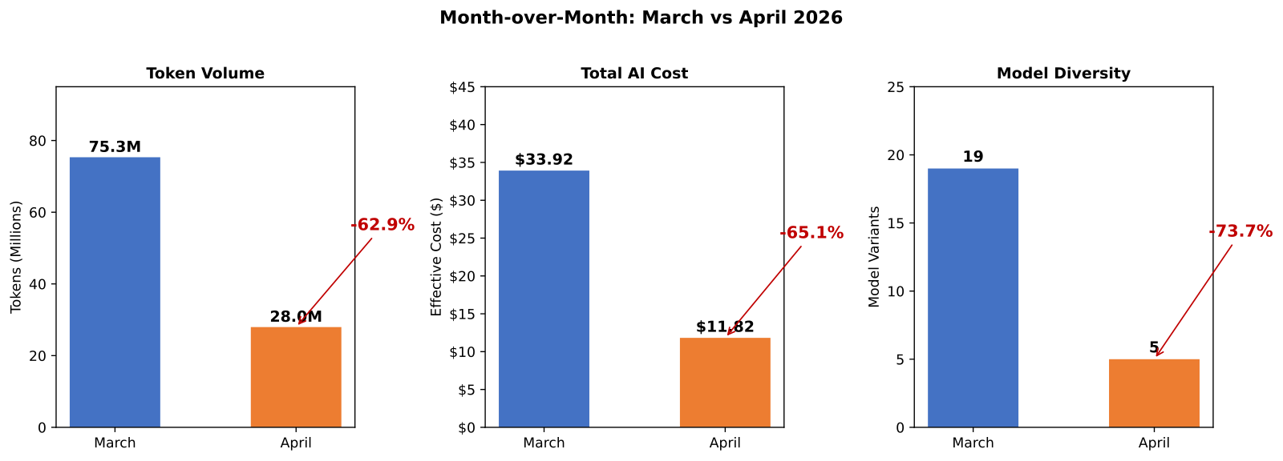
The answer
You get token-to-dollar truth now, and near-real-time remains partial.
ai-model-cost-comparison and ai-cost-by-application show $11.82 total spend across 27.96M tokens, with $0.00175 per 1K standard input, $0.000175 cached input, and $0.014 output.
The chart gives the CFO month-over-month movement, while the report shows exactly where AI money goes by model direction.
🟡 Asks #25, #26, #28
Notes:
The finance lens is simple: every token line item becomes a dollar line item. The monthly AI pack shows 27.96 million tokens translating to $11.82 total spend, then breaks the economics down by model direction. Standard input is $0.00175 per 1,000 tokens, cached input is ten times cheaper at $0.000175, and output is $0.014. That gives you an immediate charge conversation with product and engineering. The honest boundary is timing. Attribution and translation ship today. Near-real-time AI observability is only partial here because this pack runs monthly, not as a live monitor.
Sources: MCAPS asks #25,#26,#28 — "AI cost / FinOps maturity: AOAI token attribution per user / app / team"; "AI cost / FinOps maturity: Token → dollar translation + reconciliation"; "AI cost / FinOps maturity: Near-real-time AI cost observability"
Canonical: memory://work/mcaps/mcaps-internal-asks-finops-toolkit-azure-capacity-ai-cost-may-2026
Coverage verdict per canonical: 🟡 partial
Evidence pack: src/templates/sre-agent/training/release-deck/evidence/tasks/ai-workload-cost-analysis.md
Chart proof: src/templates/sre-agent/training/release-deck/charts/svg/ai-mom-comparison.svg

Slide 46
The details
Task YAML: sre-config/scheduled-tasks/ai-workload-cost-analysis.yaml
Cron: 0 10 1
KQL / tool spine: ai-model-cost-comparison + ai-cost-by-application + resource-graph-query
Monday move: srectl scheduledtask invoke ai-workload-cost-analysis
🟡 Asks #25, #26, #28
Notes:
You land the implementation detail by naming the monthly task and the exact economics it computes. ai-workload-cost-analysis.yaml runs on the first day of the month at 10:00 UTC and posts a finance-readable card. The tool chain shows model comparison, application attribution, and supporting estate context. That is enough for a CFO to inspect spend by model family and token type without reading raw Azure OpenAI meters. On Monday, invoke the task, open the card, and ask one question: which application still belongs on GPT 5.2 and which one moves down-market?
Sources: MCAPS asks #25,#26,#28 — "AI cost / FinOps maturity: AOAI token attribution per user / app / team"; "AI cost / FinOps maturity: Token → dollar translation + reconciliation"; "AI cost / FinOps maturity: Near-real-time AI cost observability"
Canonical: memory://work/mcaps/mcaps-internal-asks-finops-toolkit-azure-capacity-ai-cost-may-2026
Coverage verdict per canonical: 🟡 partial
Evidence pack: src/templates/sre-agent/training/release-deck/evidence/tasks/ai-workload-cost-analysis.md
Chart proof: src/templates/sre-agent/training/release-deck/charts/svg/ai-mom-comparison.svg

Slide 47
The ask
“&gt; "Can I put a hard brake on AI spend?"”
“&gt; "I do not want a dev project to run away for three days."”
“&gt; "Alerts are not the same as a stop button."”
🟡 Asks #27
Notes:
Keep this slide blunt. Your customer is asking for hard guardrails, not a nicer monthly budget chart. The audience already knows how often alerts arrive after the burn happened. The value in the next two slides is the honest boundary: the release can audit budget coverage, deploy budgets and anomaly alerts, and make the gap visible. It does not ship a hard cost cap or kill switch for Azure OpenAI workloads today.
Sources: MCAPS ask #27 — "AI budget hard guardrails"
Canonical: memory://work/mcaps/mcaps-internal-asks-finops-toolkit-azure-capacity-ai-cost-may-2026
Coverage verdict per canonical: 🟢 ships-today | 🟡 partial | 🔴 out-of-scope
Evidence pack: src/templates/sre-agent/training/release-deck/evidence/tasks/budget-coverage-audit.md
Chart proof: src/templates/sre-agent/training/release-deck/charts/svg/budget-alert-config.svg

Slide 48
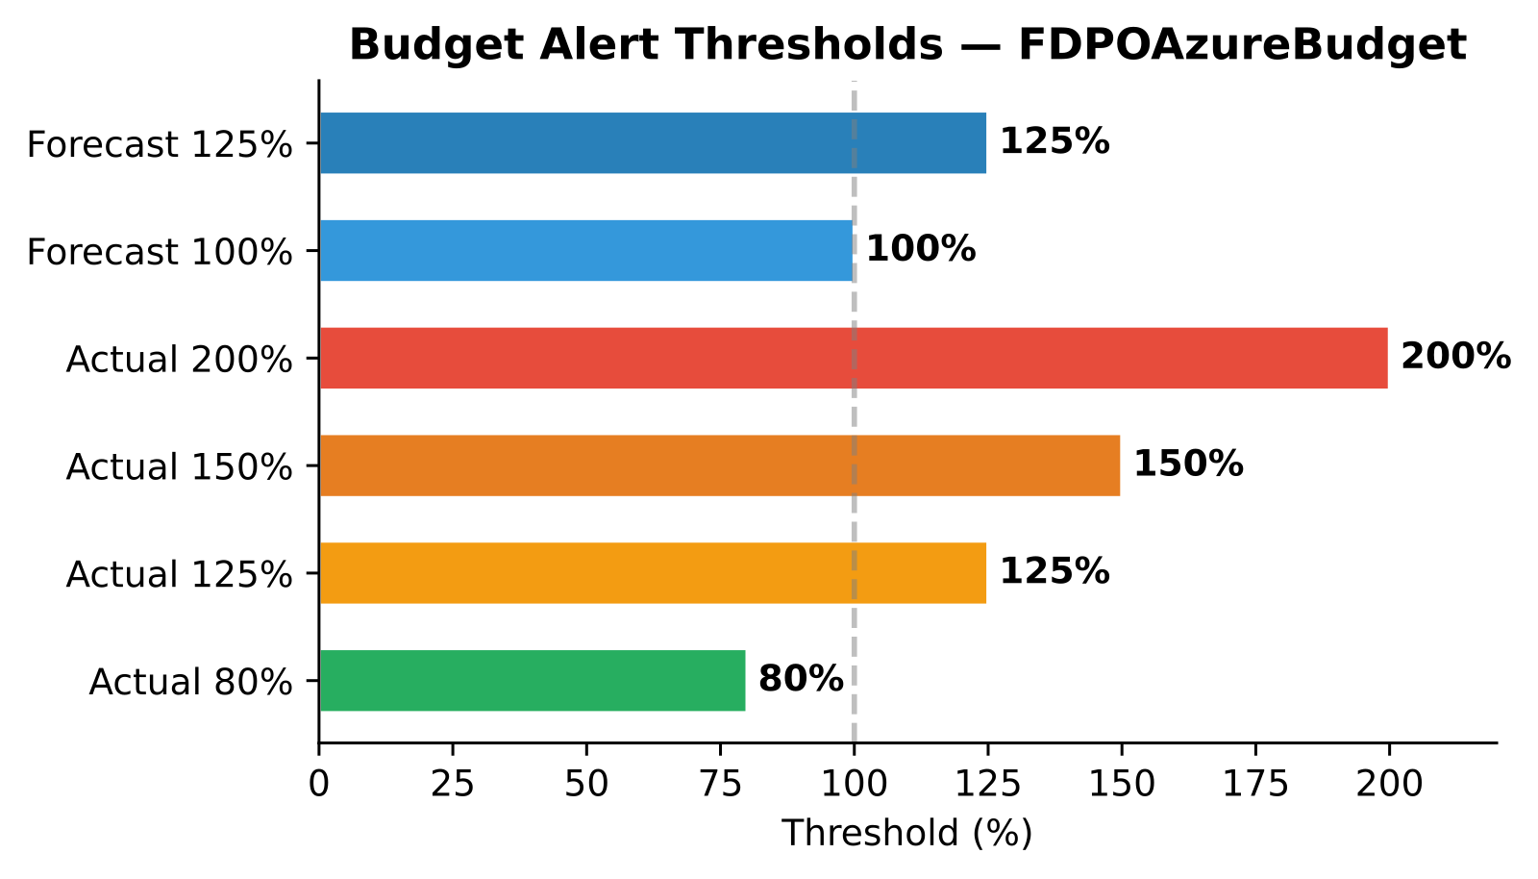
The answer
The environment has one subscription budget, FDPOAzureBudget, with 6 actual and forecast alert thresholds.
The same audit shows 0/20 resource groups with dedicated budgets, 32 policies with no budget-enforcement policy, and 0 cost anomaly alerts configured.
The write path exists through deploy-budget, deploy-bulk-budgets, deploy-anomaly-alert, and deploy-bulk-anomaly-alerts.
That is a yellow answer: alerting and deployment are present, but a hard brake pedal is not.
🟡 Asks #27
Notes:
Use the chart to separate what exists from what the customer actually wants. The release does give a concrete control surface: you can inventory budgets, show thresholding, and deploy missing budgets and anomaly alerts with named write tools. But do not imply a kill switch. The evidence is plain: there is no RG-level coverage and no anomaly alert chain today, so you are improving warning and governance, not enforcing a spend stop. That honesty keeps the field out of trouble when the customer says, "Can you block the burn at the meter?"
Sources: MCAPS ask #27 — "AI budget hard guardrails"
Canonical: memory://work/mcaps/mcaps-internal-asks-finops-toolkit-azure-capacity-ai-cost-may-2026
Coverage verdict per canonical: 🟢 ships-today | 🟡 partial | 🔴 out-of-scope
Evidence pack: src/templates/sre-agent/training/release-deck/evidence/tasks/budget-coverage-audit.md
Chart proof: src/templates/sre-agent/training/release-deck/charts/svg/budget-alert-config.svg

Slide 49
The details
budget-coverage-audit.yaml — cron 0 8 15 .
Current state from the audit: 1 subscription budget, 20 resource groups, 0 RG budgets, 32 policies, 0 budget-enforcement policy, 0 anomaly alerts.
Write tools: deploy-budget, deploy-bulk-budgets, deploy-anomaly-alert, deploy-bulk-anomaly-alerts.
Operator move: use budgets for thresholds and anomaly alerts for routing; do not describe either as a hard cap.
Monday move: srectl scheduledtask invoke budget-coverage-audit.
🟡 Asks #27
Notes:
This is where you make the yellow verdict useful. The task gives you an audit rhythm and a write path, so the field can move a customer from one coarse subscription budget to a broader coverage pattern quickly. What it still does not provide is a native brake pedal on AI consumption. Say that clearly. Then show the path you do have: audit, expand budgets, route alerts, and keep the evidence in Teams so finance and engineering see the same control state. That is an operational guardrail story, not a platform-enforced spend stop story.
Sources: MCAPS ask #27 — "AI budget hard guardrails"
Canonical: memory://work/mcaps/mcaps-internal-asks-finops-toolkit-azure-capacity-ai-cost-may-2026
Coverage verdict per canonical: 🟢 ships-today | 🟡 partial | 🔴 out-of-scope
Evidence pack: src/templates/sre-agent/training/release-deck/evidence/tasks/budget-coverage-audit.md
Chart proof: src/templates/sre-agent/training/release-deck/charts/svg/budget-alert-config.svg

Slide 50
The ask
“&gt; "Which model should my customer keep?"”
“&gt; "Which model should they stop paying for?"”
“&gt; "Can prompt design move the bill?"”
🟡 Asks #29, #30
Notes:
Read these as cost levers, not as research questions. Your customer is asking where to cut AI spend without waiting for a platform rewrite. The next two slides answer in two layers. The release gives a real model portfolio view and a clean unit-cost comparison today. It also flags prompt-economics waste with a clear signal. What it does not do is rewrite prompts or switch models automatically. That is why the cluster is mixed, not fully green.
Sources: MCAPS asks #29, #30 — "Model substitution for cost"; "Prompt optimization as cost lever"
Canonical: memory://work/mcaps/mcaps-internal-asks-finops-toolkit-azure-capacity-ai-cost-may-2026
Coverage verdict per canonical: 🟢 ships-today | 🟡 partial | 🔴 out-of-scope
Evidence pack: src/templates/sre-agent/training/release-deck/evidence/tasks/ai-workload-cost-analysis.md
Chart proof: src/templates/sre-agent/training/release-deck/charts/svg/ai-model-comparison.svg

Slide 51
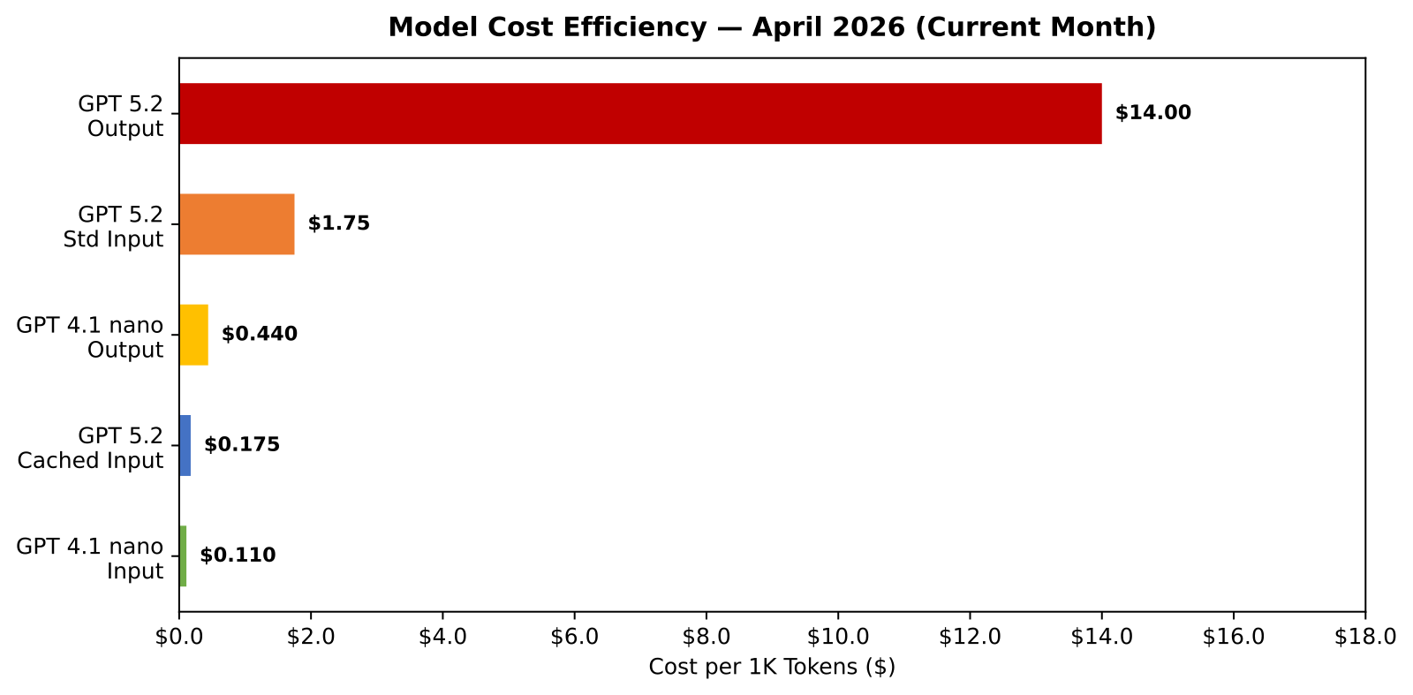
The answer
ai-model-cost-comparison shows April model consolidation from 19 variants to 5 and GPT 5.2 GA at 99.9% of spend.
GPT 4.1 nano input runs at about 16x lower input cost than GPT 5.2 GA in this estate.
The same run flags an extreme GPT 5.2 input-to-output ratio of 162:1, which points to oversized prompts and short completions.
You get a model portfolio answer today; prompt economics is an insight for the app team to act on.
🟡 Asks #29, #30
Notes:
Use the chart to show the field a concrete optimization story. The customer can see that the estate already collapsed from 19 variants to 5 and that one model now dominates the bill. That gives you a substitution discussion immediately. Then move to the second proof point: a 162:1 input-to-output ratio is not abstract FinOps language; it is a practical prompt-economics warning. Keep the yellow verdict honest. The release identifies the lever and quantifies the opportunity, but the application team still owns the model swap and the prompt rewrite decision.
Sources: MCAPS asks #29, #30 — "Model substitution for cost"; "Prompt optimization as cost lever"
Canonical: memory://work/mcaps/mcaps-internal-asks-finops-toolkit-azure-capacity-ai-cost-may-2026
Coverage verdict per canonical: 🟢 ships-today | 🟡 partial | 🔴 out-of-scope
Evidence pack: src/templates/sre-agent/training/release-deck/evidence/tasks/ai-workload-cost-analysis.md
Chart proof: src/templates/sre-agent/training/release-deck/charts/svg/ai-model-comparison.svg

Slide 52
The details
ai-workload-cost-analysis.yaml — cron 0 10 1 .
Evidence lines: GPT 5.2 standard input $0.00175/1K, cached input $0.000175/1K, output $0.014/1K, GPT 4.1 nano input $0.00011/1K.
Operator checks: model mix by x_SkuDescription, cost by direction, and input-to-output ratio by model family.
Action boundary: the task identifies the cheaper lane and the prompt-waste lane; it does not edit prompts or switch deployment defaults.
Monday move: srectl scheduledtask invoke ai-workload-cost-analysis.
🟡 Asks #29, #30
Notes:
Stay at L400 here. The field does not need another generic "optimize prompts" statement. Show the exact cost lanes and the ratio test that make the conversation credible. Then name the boundary clearly: the agent gives the evidence pack, the chart, and the ranked savings logic, while the application owner still decides whether a workload can move from GPT 5.2 to GPT 4.1 nano or whether a prompt can be shortened safely. That makes the cluster useful in real reviews instead of sounding like architecture advice without numbers.
Sources: MCAPS asks #29, #30 — "Model substitution for cost"; "Prompt optimization as cost lever"
Canonical: memory://work/mcaps/mcaps-internal-asks-finops-toolkit-azure-capacity-ai-cost-may-2026
Coverage verdict per canonical: 🟢 ships-today | 🟡 partial | 🔴 out-of-scope
Evidence pack: src/templates/sre-agent/training/release-deck/evidence/tasks/ai-workload-cost-analysis.md
Chart proof: src/templates/sre-agent/training/release-deck/charts/svg/ai-model-comparison.svg

Slide 53
The ask
“&gt; "The org chart changed after M&amp;A."”
“&gt; "Give me the daily cost movers and something I can use for showback."”
“&gt; "Do not make me wait for month-end."”
🟢 Asks #36, #37
Notes:
Set up the operating rhythm problem. Your customer is not asking for one perfect allocation model before they act. They want a daily briefing they can push into finance and engineering while the tag and ownership model is still messy. The answer here is green because the release already has a daily Teams briefing pattern with real Kusto evidence, named tools, and a trend chart. That briefing becomes the front door for chargeback design instead of the final state of chargeback itself.
Sources: MCAPS asks #36, #37 — "Post-M&amp;A tagging chaos + allocation"; "Chargeback design"
Canonical: memory://work/mcaps/mcaps-internal-asks-finops-toolkit-azure-capacity-ai-cost-may-2026
Coverage verdict per canonical: 🟢 ships-today | 🟡 partial | 🔴 out-of-scope
Evidence pack: src/templates/sre-agent/training/release-deck/evidence/tasks/mom-report.md
Chart proof: src/templates/sre-agent/training/release-deck/charts/svg/chart-monthly-cost-trend.svg

Slide 54
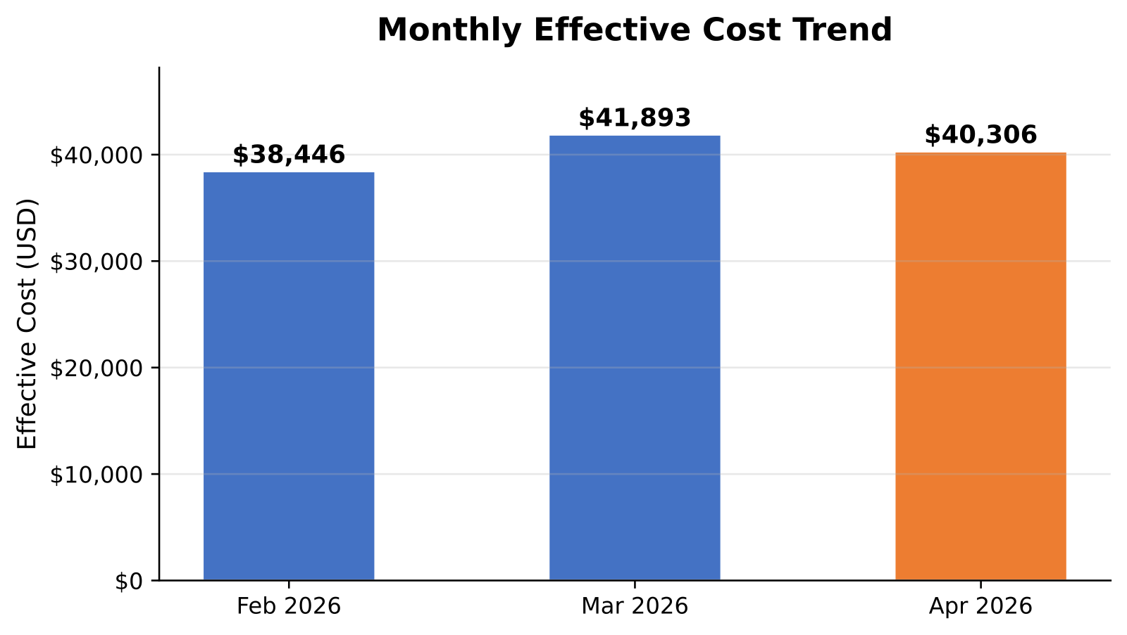
The answer
mom-report already runs on a daily cadence and posts to Teams.
The real run executes 17 Kusto queries and reports April 2026 effective cost at $40,306, ESR at 2.8%, commitment coverage at 3.5%, and a stable ~$41K/month forecast.
The chart gives you a quick read on trend direction before you drop into services, regions, and resource groups.
Tool set: monthly-cost-trend, top-services-by-cost, cost-anomaly-detection, cost-by-region-trend.
🟢 Asks #36, #37
Notes:
Say the surprising part out loud: the task is named month-over-month, but the shipped YAML runs daily and posts to Teams. That is exactly why it works as a cost-mover briefing. The customer gets a repeatable executive card with real numbers, a chart, and enough drill-down hooks to start showback conversations before the allocation model is perfect. Keep the green verdict because the rhythm, chart, and evidence all exist today. Then remind the room that chargeback design still needs ownership and tagging decisions; this briefing is the operating cadence that keeps those decisions moving.
Sources: MCAPS asks #36, #37 — "Post-M&amp;A tagging chaos + allocation"; "Chargeback design"
Canonical: memory://work/mcaps/mcaps-internal-asks-finops-toolkit-azure-capacity-ai-cost-may-2026
Coverage verdict per canonical: 🟢 ships-today | 🟡 partial | 🔴 out-of-scope
Evidence pack: src/templates/sre-agent/training/release-deck/evidence/tasks/mom-report.md
Chart proof: src/templates/sre-agent/training/release-deck/charts/svg/chart-monthly-cost-trend.svg

Slide 55
The details
mom-report.yaml — cron 15 17 *.
Query chain includes monthly-cost-trend, top-services-by-cost, top-resource-groups-by-cost, cost-anomaly-detection, savings-summary-report, commitment-discount-utilization, cost-forecasting-model, and cost-by-region-trend.
Delivery: PostTeamsMessage with chart, grade card, forecast, and next actions.
Use the daily card as the working brief for allocation cleanup and chargeback design reviews.
Monday move: srectl scheduledtask invoke mom-report.
🟢 Asks #36, #37
Notes:
This slide matters because it turns an abstract "daily briefing" story into an operator artifact. Show the cron, the query chain, and the Teams delivery in one breath. Your field move is simple: run the task against the customer Hub, drop the Teams card into the weekly operating room, and use that same card to drive which services, regions, and resource groups need follow-up. That is how you bridge from cost-mover visibility into allocation and chargeback work without waiting for a perfect back-office taxonomy first.
Sources: MCAPS asks #36, #37 — "Post-M&amp;A tagging chaos + allocation"; "Chargeback design"
Canonical: memory://work/mcaps/mcaps-internal-asks-finops-toolkit-azure-capacity-ai-cost-may-2026
Coverage verdict per canonical: 🟢 ships-today | 🟡 partial | 🔴 out-of-scope
Evidence pack: src/templates/sre-agent/training/release-deck/evidence/tasks/mom-report.md
Chart proof: src/templates/sre-agent/training/release-deck/charts/svg/chart-monthly-cost-trend.svg

Slide 56
The ask
“&gt; "Is the reporting pipe ready enough for anomaly automation?"”
“&gt; "What is missing right now?"”
“&gt; "What do I deploy next?"”
🟢 Asks #41
Notes:
This ask is really about readiness. Your customer wants to know whether anomaly management is a live operating chain or just another idea in the backlog. Keep the slide clean, then use the next two slides to show the sequence: audit what exists, prove the gaps, then use the write tools to deploy the missing alerting pieces. That is why the cluster is green. The answer is not that every environment already has anomaly alerts. The answer is that the release gives you the audit-to-deploy chain today.
Sources: MCAPS ask #41 — "Cost reporting pipeline readiness"
Canonical: memory://work/mcaps/mcaps-internal-asks-finops-toolkit-azure-capacity-ai-cost-may-2026
Coverage verdict per canonical: 🟢 ships-today | 🟡 partial | 🔴 out-of-scope
Evidence pack: src/templates/sre-agent/training/release-deck/evidence/tasks/alert-coverage-audit.md
Chart proof: src/templates/sre-agent/training/release-deck/charts/svg/alert-coverage-matrix.svg

Slide 57
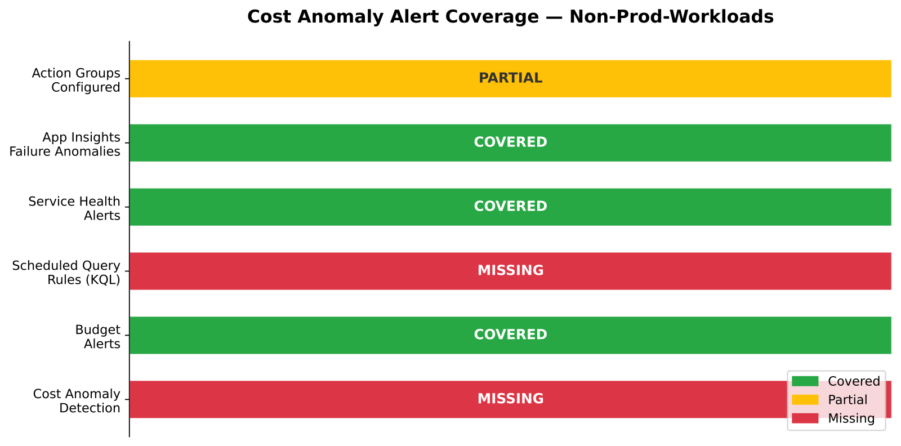
The answer
alert-coverage-audit inventories the current state before you touch anything.
The real run finds 8 alert resources total, but 0 cost anomaly alerts and 0 scheduled query rules.
It also finds budget and health alerts routing to a single action group path and no FinOps Hub KQL alert layer.
From there you use deploy-anomaly-alert or deploy-bulk-anomaly-alerts to add the missing chain.
🟢 Asks #41
Notes:
Show the matrix and keep the story linear. First you audit. Then you prove the exact gap. Then you deploy the missing anomaly alert path. That is what makes the answer operational instead of theoretical. The room should notice that the evidence is not flattering: zero cost anomaly alerts and zero scheduled query rules exist today. That is fine. A green verdict here means the release gives you the chain to find the hole and fix it with named write tools, not that every customer already has full anomaly coverage.
Sources: MCAPS ask #41 — "Cost reporting pipeline readiness"
Canonical: memory://work/mcaps/mcaps-internal-asks-finops-toolkit-azure-capacity-ai-cost-may-2026
Coverage verdict per canonical: 🟢 ships-today | 🟡 partial | 🔴 out-of-scope
Evidence pack: src/templates/sre-agent/training/release-deck/evidence/tasks/alert-coverage-audit.md
Chart proof: src/templates/sre-agent/training/release-deck/charts/svg/alert-coverage-matrix.svg

Slide 58
The details
alert-coverage-audit.yaml — cron 0 8 16 .
Inputs: Azure Resource Graph, Cost Management alert inventory, Hub anomaly checks, action-group routing review.
Gaps from the real run: 0 cost anomaly alerts, 0 scheduled query rules, single-person routing, Transactions() still empty.
Write path: deploy-anomaly-alert, deploy-bulk-anomaly-alerts after the audit evidence lands.
Monday move: srectl scheduledtask invoke alert-coverage-audit.
🟢 Asks #41
Notes:
This is the operator chain the field can repeat. The audit task does the inventory, the chart makes the absence visible, and the write tools let you move from observation into deployment. Keep the emphasis on order. If you skip the audit, you miss routing gaps and duplicate coverage. If you stop at the audit, you leave the customer with another red box and no next action. This slide turns anomaly management into a repeatable monthly control loop that fits a real operating calendar.
Sources: MCAPS ask #41 — "Cost reporting pipeline readiness"
Canonical: memory://work/mcaps/mcaps-internal-asks-finops-toolkit-azure-capacity-ai-cost-may-2026
Coverage verdict per canonical: 🟢 ships-today | 🟡 partial | 🔴 out-of-scope
Evidence pack: src/templates/sre-agent/training/release-deck/evidence/tasks/alert-coverage-audit.md
Chart proof: src/templates/sre-agent/training/release-deck/charts/svg/alert-coverage-matrix.svg

Slide 59
The ask
“Can finance trust the numbers, can I see where AI spend is heading, and can I get one pane across the estate?”
CFO / controller / FinOps lead
🟡 Asks #32, #33, #34
Notes:
This is the finance trust slide. The customer is really asking three things at once: data credibility, forward visibility, and scope. You answer the first two with strong evidence and the third with a scoped answer. The deck should sound calm here. Finance buyers respond to repeatable reporting, freshness checks, and explicit limits. They do not need a promise of universal normalization. They need to hear that the Azure estate is measurable now, the forecast is current now, and the boundary for multi-cloud normalization is stated clearly instead of buried later in the deal cycle.
Sources: MCAPS asks #32,#33,#34 — "CFO / finance buyer: CFO reconciliation trust gap (portal / invoice / FOCUS)"; "CFO / finance buyer: CFO: AI spend forecast + brake pedal"; "CFO / finance buyer: Multi-tenant / multi-cloud single pane"
Canonical: memory://work/mcaps/mcaps-internal-asks-finops-toolkit-azure-capacity-ai-cost-may-2026
Coverage verdict per canonical: 🟡 partial
Evidence pack: src/templates/sre-agent/training/release-deck/evidence/tasks/ytd-report.md
Chart proof: src/templates/sre-agent/training/release-deck/charts/svg/fy-cost-trend-forecast.svg

Slide 60
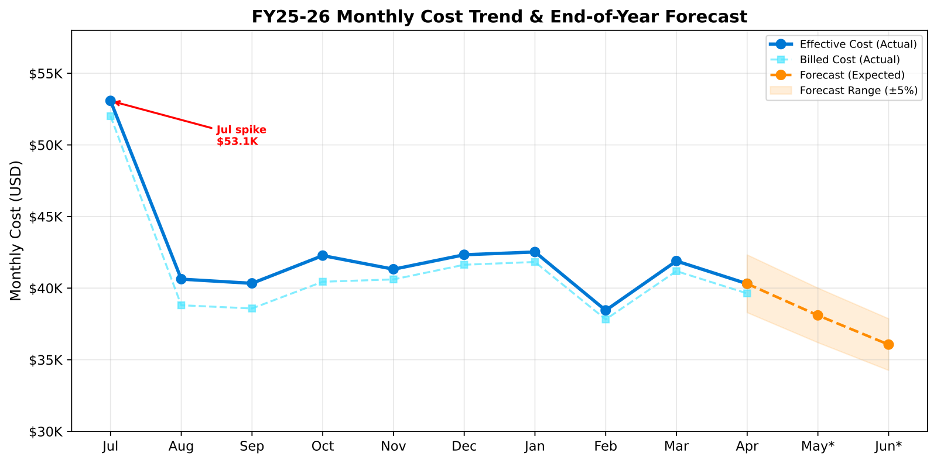
The answer
You get reconciliation-grade Azure reporting today, and multi-cloud normalization remains partial.
monthly-cost-trend, cost-forecasting-model, savings-summary-report, and quarterly-cost-by-resource-group show YTD spend of $423,131, projected FY spend of $497K, ESR of 3.5%, and three prioritized actions before year-end.
hubs-health-check and hub scope validation add freshness proof and 24-subscription coverage.
🟡 Asks #32, #33, #34
Notes:
You answer trust with numbers plus freshness. The YTD card shows $423,131 through April and an expected full-year view of about $497K. The finance readout also calls out ESR at 3.5 percent versus the target range and points to the actions that matter before year-end. Then you add the credibility layer: the hub checks Costs, Prices, Recommendations, and the open Transactions gap, and the monitoring scope pass shows 24 subscriptions in coverage. That is a real single pane for Azure. The honest line is multi-cloud. That remains a separate architecture decision, not a hidden feature claim.
Sources: MCAPS asks #32,#33,#34 — "CFO / finance buyer: CFO reconciliation trust gap (portal / invoice / FOCUS)"; "CFO / finance buyer: CFO: AI spend forecast + brake pedal"; "CFO / finance buyer: Multi-tenant / multi-cloud single pane"
Canonical: memory://work/mcaps/mcaps-internal-asks-finops-toolkit-azure-capacity-ai-cost-may-2026
Coverage verdict per canonical: 🟡 partial
Evidence pack: src/templates/sre-agent/training/release-deck/evidence/tasks/ytd-report.md
Chart proof: src/templates/sre-agent/training/release-deck/charts/svg/fy-cost-trend-forecast.svg

Slide 61
The details
Task YAMLs: sre-config/scheduled-tasks/ytd-report.yaml and sre-config/scheduled-tasks/mom-report.yaml
Crons: 0 9 1 and 15 17 *
KQL / tool spine: monthly-cost-trend + cost-forecasting-model + savings-summary-report + quarterly-cost-by-resource-group + data-freshness-check
Monday move: srectl scheduledtask invoke ytd-report
🟡 Asks #32, #33, #34
Notes:
The L400 point is that finance trust comes from cadence plus controls. ytd-report.yaml gives the monthly executive readout. mom-report.yaml keeps a daily and monthly trend line in motion. The tool chain spans trend, forecast, savings, resource-group drilldown, and freshness validation. That is why the numbers hold up in a reconciliation conversation. You also keep the hard truth on the slide: 86.6 percent untagged spend and a Transactions gap both affect downstream finance workflows. On Monday, run the YTD pack with the customer and review the forecast, the ESR gap, and the first three actions together.
Sources: MCAPS asks #32,#33,#34 — "CFO / finance buyer: CFO reconciliation trust gap (portal / invoice / FOCUS)"; "CFO / finance buyer: CFO: AI spend forecast + brake pedal"; "CFO / finance buyer: Multi-tenant / multi-cloud single pane"
Canonical: memory://work/mcaps/mcaps-internal-asks-finops-toolkit-azure-capacity-ai-cost-may-2026
Coverage verdict per canonical: 🟡 partial
Evidence pack: src/templates/sre-agent/training/release-deck/evidence/tasks/ytd-report.md
Chart proof: src/templates/sre-agent/training/release-deck/charts/svg/fy-cost-trend-forecast.svg

Slide 62
The ask
“&gt; "Are the numbers fresh?"”
“&gt; "Did the pipeline miss anything?"”
“&gt; "Can finance trust this before the QBR starts?"”
🟢 Asks #38, #58, #66
Notes:
Keep the ask universal. Every field seller and every finance lead has heard this exact trust challenge. The answer in this release is green because the agent gives a concrete freshness verdict with counts, staleness, and open issues, then posts it into Teams. What it does not do is silently heal missing exports or bad upstream tagging. That is why the notes should keep saying "verdict" and "boundary." The value is the trust line, not magic ingestion repair.
Sources: MCAPS asks #38, #58, #66 — "Tagging inheritance workarounds and pipeline data quality"; "Pipeline failures / stale data"; "Finance trust / data credibility"
Canonical: memory://work/mcaps/mcaps-internal-asks-finops-toolkit-azure-capacity-ai-cost-may-2026
Coverage verdict per canonical: 🟢 ships-today | 🟡 partial | 🔴 out-of-scope
Evidence pack: src/templates/sre-agent/training/release-deck/evidence/tasks/hubs-health-check.md
Chart proof: src/templates/sre-agent/training/release-deck/charts/svg/data-freshness.svg

Slide 63
The answer
data-freshness-check gives a direct verdict on Hub credibility.
The real run shows Costs() at 1,266,578 rows with 1 day staleness, Prices() at 14,343,006 rows, Recommendations() at 45 rows, and Transactions() at 0 rows.
monitoring-scope-validation adds 24 monitored subscriptions and flags 2,332 cost rows with empty SubAccountId.
You can tell finance exactly what is healthy, what is empty, and what still needs investigation before they reconcile.
🟢 Asks #38, #58, #66
Notes:
Walk the audience through the chart like a finance control readout. Healthy cost rows, healthy price rows, recommendations present, transactions empty, and a measurable scope issue around empty SubAccountId. That is the point. The release does not hide the data-quality boundary behind a green check. It gives you a precise trust statement you can repeat in QBR prep, close review, or weekly operating calls. That is why this cluster is green: the verdict ships today and the evidence is specific enough for finance, not just for engineers.
Sources: MCAPS asks #38, #58, #66 — "Tagging inheritance workarounds and pipeline data quality"; "Pipeline failures / stale data"; "Finance trust / data credibility"
Canonical: memory://work/mcaps/mcaps-internal-asks-finops-toolkit-azure-capacity-ai-cost-may-2026
Coverage verdict per canonical: 🟢 ships-today | 🟡 partial | 🔴 out-of-scope
Evidence pack: src/templates/sre-agent/training/release-deck/evidence/tasks/monitoring-scope-validation.md
Chart proof: src/templates/sre-agent/training/release-deck/charts/svg/data-freshness.svg

Slide 64
The details
hubs-health-check.yaml — cron 0 6 *.
data-freshness-check and monitoring-scope-validation test function row counts, staleness, version, subscription coverage, and empty SubAccountId rows.
Freshness boundary from the real run: Transactions() empty, hub version 13.0 behind 14.0, SubAccountId gaps still present.
Delivery path: PostTeamsMessage with open issues and action items.
Monday move: srectl scheduledtask invoke hubs-health-check.
🟢 Asks #38, #58, #66
Notes:
Make this slide feel like an operating control, not a diagnostics demo. Your customer needs a daily freshness verdict and a weekly scope check because those are the two moments where trust breaks: stale data and incomplete coverage. The YAML and the named checks make that operating model explicit. Then say the credibility line again: the task is valuable because it tells finance what not to trust yet. A red or yellow issue on freshness is not a failure of the slide. It is the reason the slide earns trust in the first place.
Sources: MCAPS asks #38, #58, #66 — "Tagging inheritance workarounds and pipeline data quality"; "Pipeline failures / stale data"; "Finance trust / data credibility"
Canonical: memory://work/mcaps/mcaps-internal-asks-finops-toolkit-azure-capacity-ai-cost-may-2026
Coverage verdict per canonical: 🟢 ships-today | 🟡 partial | 🔴 out-of-scope
Evidence pack: src/templates/sre-agent/training/release-deck/evidence/tasks/hubs-health-check.md
Chart proof: src/templates/sre-agent/training/release-deck/charts/svg/data-freshness.svg

Slide 65
The ask
“&gt; "Show me the RI and savings-plan math in the Hub."”
“&gt; "Then show me why it does or does not match the portal."”
“&gt; "Do not hand me two different stories."”
🟡 Asks #62, #63
Notes:
This ask is where finance trust and rate optimization collide. Your customer wants commitment math they can act on and a clean explanation when the Hub and the portal do not line up perfectly. Set expectation early that the cluster is mixed. The release gives strong RI and SP math, rankings, and savings logic today. Full portal-side reconciliation stays partial because one missing data source still matters: Transactions() is empty in the evidence pack, so purchase-side validation remains incomplete.
Sources: MCAPS asks #62, #63 — "RI/SP math in Hub"; "Portal reconciliation Kusto vs portal"
Canonical: memory://work/mcaps/mcaps-internal-asks-finops-toolkit-azure-capacity-ai-cost-may-2026
Coverage verdict per canonical: 🟢 ships-today | 🟡 partial | 🔴 out-of-scope
Evidence pack: src/templates/sre-agent/training/release-deck/evidence/tasks/benefit-recommendation-review.md
Chart proof: src/templates/sre-agent/training/release-deck/charts/svg/chart-commitment-savings.svg

Slide 66
The answer
benefit-recommendations, commitment-discount-utilization, and savings-summary-report give the rate-optimization math.
The real run identifies 20 RI recommendations, 1 compute savings-plan recommendation, 2.8% ESR, 96.5% on-demand core-hours, and $12,739/month in RI savings opportunity.
The same review warns that Transactions() is still empty, so you cannot fully validate existing commitment purchases against the recommendation set.
You get a finance-ready savings case today and a partial reconciliation answer when portal purchase evidence is missing.
🟡 Asks #62, #63
Notes:
Use the chart to separate the green part from the yellow part. Green: the Hub gives ranked RI and SP opportunities with savings values, break-even periods, and utilization context. Yellow: if the customer asks whether every current purchase and discount line reconciles cleanly back to the portal, you must say the evidence pack still has a Transactions() gap. That does not invalidate the savings case. It means the field should position the Hub as strong on opportunity math and still cautious on complete purchase-side reconciliation until the transaction export path is fixed.
Sources: MCAPS asks #62, #63 — "RI/SP math in Hub"; "Portal reconciliation Kusto vs portal"
Canonical: memory://work/mcaps/mcaps-internal-asks-finops-toolkit-azure-capacity-ai-cost-may-2026
Coverage verdict per canonical: 🟢 ships-today | 🟡 partial | 🔴 out-of-scope
Evidence pack: src/templates/sre-agent/training/release-deck/evidence/tasks/benefit-recommendation-review.md
Chart proof: src/templates/sre-agent/training/release-deck/charts/svg/chart-commitment-savings.svg

Slide 67
The details
benefit-recommendation-review.yaml — cron 0 8 5.
Supporting task: cost-optimization.yaml — cron 0 8 1.
Math from the run: ESR 2.8%, reserved core-hours 3.5%, on-demand core-hours 96.5%, RI savings $12,739/month, SP opportunity $41,454/month over 3 years.
Reconciliation boundary: use Transactions() and commitment records for purchase-side proof; when Transactions() is empty, keep the verdict yellow.
Monday move: srectl scheduledtask invoke benefit-recommendation-review.
🟡 Asks #62, #63
Notes:
Show the field exactly how to keep this conversation honest. The weekly benefit review gives the numbers that start the commitment discussion. The weekly cost optimization report gives supporting context on ESR and top opportunities. Then you state the yellow line cleanly: recommendation math is strong, but portal reconciliation depends on transaction evidence that is not present in this run. That is the kind of answer finance leaders trust, because it tells them which part of the story is solid now and which part needs a data-path fix before a purchase program accelerates.
Sources: MCAPS asks #62, #63 — "RI/SP math in Hub"; "Portal reconciliation Kusto vs portal"
Canonical: memory://work/mcaps/mcaps-internal-asks-finops-toolkit-azure-capacity-ai-cost-may-2026
Coverage verdict per canonical: 🟢 ships-today | 🟡 partial | 🔴 out-of-scope
Evidence pack: src/templates/sre-agent/training/release-deck/evidence/tasks/benefit-recommendation-review.md
Chart proof: src/templates/sre-agent/training/release-deck/charts/svg/chart-commitment-savings.svg

Slide 68
The ask
“&gt; "The tags are broken after M&amp;A."”
“&gt; "Can you tell me what we cannot allocate?"”
“&gt; "Do not promise auto-remediation if it is not there."”
🟡 Asks #36, #38
Notes:
Keep the quote harsh. That is what makes the yellow answer credible. Your customer is not looking for a theory of cost allocation. They want to know how bad the hygiene problem is and whether the release can prove the gap without pretending to fix it automatically. The next two slides do exactly that. They show a measured tag-coverage picture and a repeatable audit path, then stop short of claiming automatic tag repair or inherited tagging workarounds that are not in this release.
Sources: MCAPS asks #36, #38 — "Post-M&amp;A tagging chaos"; "Tagging inheritance workarounds"
Canonical: memory://work/mcaps/mcaps-internal-asks-finops-toolkit-azure-capacity-ai-cost-may-2026
Coverage verdict per canonical: 🟢 ships-today | 🟡 partial | 🔴 out-of-scope
Evidence pack: src/templates/sre-agent/training/release-deck/evidence/tasks/budget-coverage-audit.md
Chart proof: src/templates/sre-agent/training/release-deck/charts/svg/tag-coverage-audit.svg

Slide 69
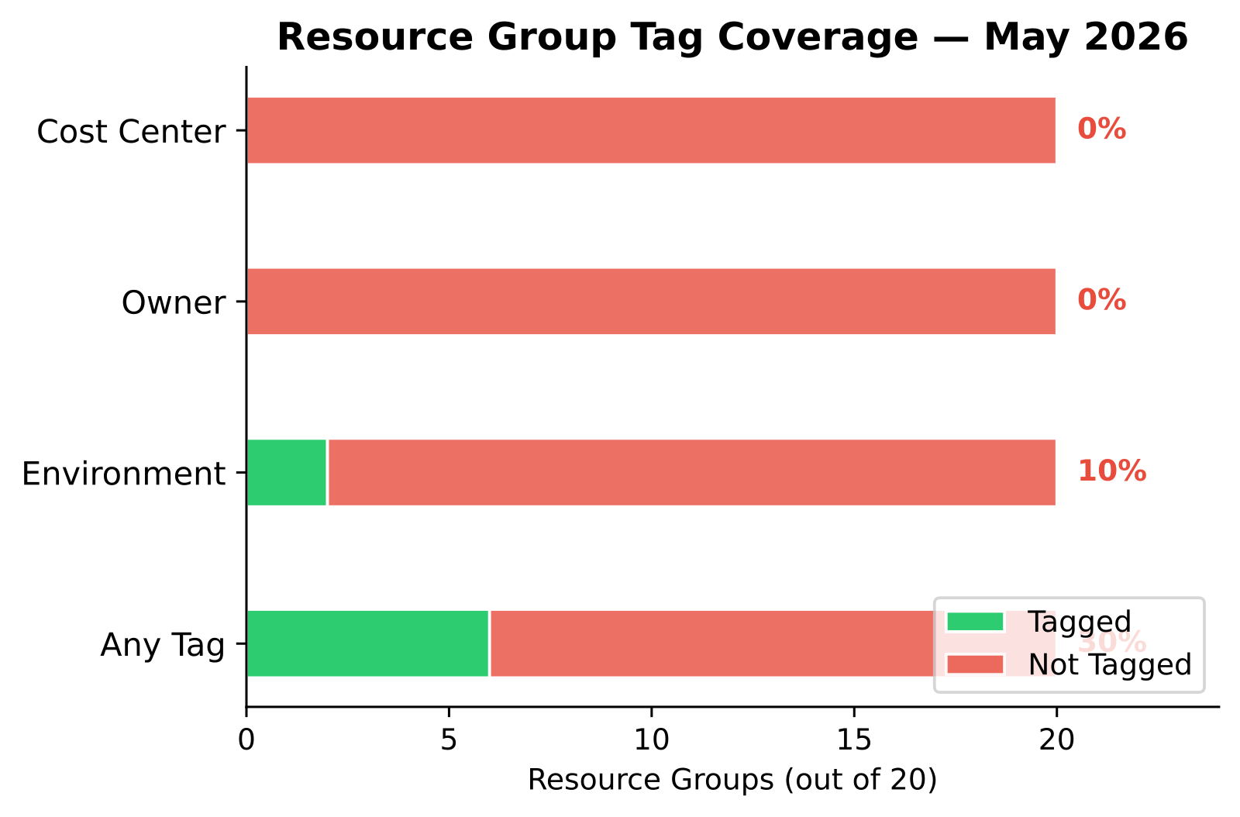
The answer
resource-graph-query and the budget coverage audit make the hygiene gap visible fast.
The real run shows 0% Owner tag coverage, 0% CostCenter coverage, and only 10% Environment coverage across 20 resource groups.
The YTD report adds the cost lens: 86.6% of spend is still untagged.
That is a yellow answer: you can prove the allocation problem and rank the cleanup, but the release does not auto-remediate the tags.
🟡 Asks #36, #38
Notes:
Put the percentages on screen and stop. Those three numbers tell the story better than a long governance lecture. Then connect them to money: the YTD report says most spend is still untagged, which means chargeback and accountability are weak before anyone argues about the right taxonomy. Keep the verdict yellow and say why. The agent gives you the audit evidence and the recurring cadence. It does not reach into the estate and repair missing Owner or CostCenter tags on its own. That honesty is what keeps the field out of over-claim territory.
Sources: MCAPS asks #36, #38 — "Post-M&amp;A tagging chaos"; "Tagging inheritance workarounds"
Canonical: memory://work/mcaps/mcaps-internal-asks-finops-toolkit-azure-capacity-ai-cost-may-2026
Coverage verdict per canonical: 🟢 ships-today | 🟡 partial | 🔴 out-of-scope
Evidence pack: src/templates/sre-agent/training/release-deck/evidence/tasks/ytd-report.md
Chart proof: src/templates/sre-agent/training/release-deck/charts/svg/tag-coverage-audit.svg

Slide 70
The details
budget-coverage-audit.yaml — cron 0 8 15 .
Inputs: Resource Graph for tags, budget inventory, policy assignments, and resource-group coverage.
Supporting finance view: ytd-report.yaml adds the spend-weighted result, including 86.6% untagged spend.
Operator boundary: detect, quantify, route, and track; do not describe this as tag auto-remediation.
Monday move: srectl scheduledtask invoke budget-coverage-audit.
🟡 Asks #36, #38
Notes:
This slide is where you make the yellow verdict actionable. The budget audit gives the structural hygiene picture, and the YTD report tells you how much money is exposed because that hygiene is weak. That pairing is enough to start a post-M&amp;A cleanup program with finance and engineering in the same room. Then state the limit one more time: the release provides the audit motion and the evidence cadence, not an automated tag repair service. That clear boundary is what makes the story safe to repeat with customers who are already skeptical about allocation claims.
Sources: MCAPS asks #36, #38 — "Post-M&amp;A tagging chaos"; "Tagging inheritance workarounds"
Canonical: memory://work/mcaps/mcaps-internal-asks-finops-toolkit-azure-capacity-ai-cost-may-2026
Coverage verdict per canonical: 🟢 ships-today | 🟡 partial | 🔴 out-of-scope
Evidence pack: src/templates/sre-agent/training/release-deck/evidence/tasks/budget-coverage-audit.md
Chart proof: src/templates/sre-agent/training/release-deck/charts/svg/tag-coverage-audit.svg

Slide 71
The ask
“&gt; "Do not give me a maturity poster."”
“&gt; "Show me the operating model."”
“&gt; "What runs daily, weekly, monthly, and quarterly?"”
🟢 Asks #43, #45
Notes:
This ask is a gift because it forces precision. Your customer is not asking whether you know the FinOps Framework vocabulary. They want to know whether the framework becomes a calendar with named tasks, owners, and outputs. The answer is green because that calendar already exists in the scheduled-task catalog and the evidence pack. The next two slides show the visual maturity story and the actual operating rhythm behind it. That is how you move from strategy language to work that runs on Monday morning.
Sources: MCAPS asks #43, #45 — "FinOps maturity assessment"; "FinOps Framework operationalization"
Canonical: memory://work/mcaps/mcaps-internal-asks-finops-toolkit-azure-capacity-ai-cost-may-2026
Coverage verdict per canonical: 🟢 ships-today | 🟡 partial | 🔴 out-of-scope
Evidence pack: src/templates/sre-agent/training/release-deck/evidence/tasks/capacity-quarterly-strategy.md
Chart proof: src/templates/sre-agent/training/release-deck/charts/svg/chart3-governance-scorecard.svg

Slide 72
The answer
The operating model is the schedule, not a maturity poster alone.
CATALOG.md maps recurring tasks across budgeting, forecasting, allocation, anomaly management, unit economics, rate optimization, and capacity operations.
The quarterly strategy evidence scores Forecast, Procure, and Allocate at Crawl, with Monitor at Walk.
The radar chart gives the score; the catalog gives the tasks that move the score.
🟢 Asks #43, #45
Notes:
Make the distinction explicit. Many framework conversations die as soon as the maturity chart goes up because the audience cannot see how it changes daily work. This release fixes that by pairing the scorecard with a catalog of scheduled tasks. Use the chart to show current posture, then immediately point to the catalog as the operational answer: what runs, when it runs, who owns it, and which capability it maps to. That is why the verdict is green. The framework is not just referenced. It is operationalized in the shipped task roster.
Sources: MCAPS asks #43, #45 — "FinOps maturity assessment"; "FinOps Framework operationalization"
Canonical: memory://work/mcaps/mcaps-internal-asks-finops-toolkit-azure-capacity-ai-cost-may-2026
Coverage verdict per canonical: 🟢 ships-today | 🟡 partial | 🔴 out-of-scope
Evidence pack: src/templates/sre-agent/training/release-deck/evidence/tasks/capacity-quarterly-strategy.md
Chart proof: src/templates/sre-agent/training/release-deck/charts/svg/chart3-governance-scorecard.svg

Slide 73
The details
CATALOG.md is the operating map: daily, weekly, monthly, quarterly, annual, capacity, and AI task bands.
Evidence from capacity-quarterly-strategy ties the scorecard to concrete gaps: low ESR, no anomaly alerts, no CRGs, and Crawl posture in Forecast, Procure, and Allocate.
Operator rule: start with a small live set, then expand the task roster as the customer proves the cadence.
Monday move: open src/templates/sre-agent/CATALOG.md and map the first three tasks to the customer operating calendar.
🟢 Asks #43, #45
Notes:
This is the slide where the field sees how to use the framework without drowning the customer in a 40-task rollout. Show the catalog bands, then tell them to pick the first live motions: a daily health or cost signal, a weekly optimization or supply review, and a monthly finance report. That is enough to move from theory into rhythm. Because the evidence already shows which maturity dimensions lag, you can choose the first tasks based on measured gaps instead of preference. That is what makes the framework operational and not just well-labeled.
Sources: MCAPS asks #43, #45 — "FinOps maturity assessment"; "FinOps Framework operationalization"
Canonical: memory://work/mcaps/mcaps-internal-asks-finops-toolkit-azure-capacity-ai-cost-may-2026
Coverage verdict per canonical: 🟢 ships-today | 🟡 partial | 🔴 out-of-scope
Evidence pack: src/templates/sre-agent/training/release-deck/evidence/tasks/capacity-quarterly-strategy.md
Chart proof: src/templates/sre-agent/training/release-deck/charts/svg/chart3-governance-scorecard.svg

Slide 74
The ask
“&gt; "Finance never opened the dashboard."”
“&gt; "How do I get this into the weekly rhythm?"”
“&gt; "Send me what matters where the team already works."”
🟢 Asks #70
Notes:
This ask is about behavior, not visualization. Your customer is telling you the dashboard failed as a delivery model. Keep the slide light and let that land. The green answer is simple and powerful: stop treating the dashboard as the destination and move the operating output into Teams cards that arrive on a schedule. The evidence pack has that pattern already. The field can show it without inventing a change-management theory on the spot.
Sources: MCAPS ask #70 — "Dashboard adoption failure"
Canonical: memory://work/mcaps/mcaps-internal-asks-finops-toolkit-azure-capacity-ai-cost-may-2026
Coverage verdict per canonical: 🟢 ships-today | 🟡 partial | 🔴 out-of-scope
Evidence pack: src/templates/sre-agent/training/release-deck/evidence/tasks/capacity-weekly-supply-review.md
Chart proof: None

Slide 75
The answer
The answer is PostTeamsMessage, not another dashboard tab.
capacity-daily-monitor and capacity-weekly-supply-review already deliver the operating brief as Teams cards with findings, charts, and next actions.
The weekly proof pack posts quota headroom, CRG state, SKU availability, and top reservation opportunities straight into the channel the operators already read.
Your field message is simple: if 80% never opened the dashboard, move the cadence to Teams.
🟢 Asks #70
Notes:
Say the blunt line exactly once: stop building dashboards for a workflow that already lives in Teams. Then point to the evidence. The shipped tasks already post structured summaries with the signals the team needs, and they do it on a schedule. That changes adoption because the customer does not have to remember to open anything. The information arrives in the operating room. The green verdict matters here because the release has already proven the delivery mechanism. You are not pitching a behavior change without a tool path behind it.
Sources: MCAPS ask #70 — "Dashboard adoption failure"
Canonical: memory://work/mcaps/mcaps-internal-asks-finops-toolkit-azure-capacity-ai-cost-may-2026
Coverage verdict per canonical: 🟢 ships-today | 🟡 partial | 🔴 out-of-scope
Evidence pack: src/templates/sre-agent/training/release-deck/evidence/tasks/capacity-weekly-supply-review.md
Chart proof: None

Slide 76
The details
Every scheduled-task entrypoint that delivers results uses PostTeamsMessage when a Teams channel is configured.
The run checks Teams capability once, then posts the final card into the configured channel.
Evidence tasks: capacity-daily-monitor, capacity-weekly-supply-review, mom-report, and the AI cost reports all follow the same delivery pattern.
Operator rule: treat the Teams card as the operating artifact and the dashboard as optional follow-up context.
Monday move: wire the channel, then invoke one weekly task.
🟢 Asks #70
Notes:
This is where you tie the adoption story back to the platform contract. The AGENTS guidance is explicit: when a Teams connector and channel exist, the scheduled task succeeds through Teams delivery. That means the operating artifact is the card, not the dashboard. Your customer can still keep dashboards for exploration, but the cadence lands through a channel the team already watches. That is a cleaner answer than trying to rescue adoption through training or more dashboard tabs. The release already gives you the delivery pattern; you just need to use it consistently.
Sources: MCAPS ask #70 — "Dashboard adoption failure"
Canonical: memory://work/mcaps/mcaps-internal-asks-finops-toolkit-azure-capacity-ai-cost-may-2026
Coverage verdict per canonical: 🟢 ships-today | 🟡 partial | 🔴 out-of-scope
Evidence pack: src/templates/sre-agent/training/release-deck/evidence/tasks/capacity-weekly-supply-review.md
Chart proof: None

Slide 77
The ask
“&gt; "Azure Cost Management already gives me budgets and charts."”
“&gt; "What exactly do you add on top?"”
“&gt; "Show me the gap, not the slogan."”
🟢 Asks #48
Notes:
This ask should make the room more confident, not defensive. Your customer is right to challenge the overlap. The answer is green because the release proves where native coverage is thin, then shows the operational layers this agent adds: anomaly audit and deployment path, Teams delivery, and governance around things like Advisor suppressions. The next two slides should feel concrete and almost a little uncomfortable, because the evidence says the native picture is not enough in this environment today.
Sources: MCAPS ask #48 — "Azure CM native gaps"
Canonical: memory://work/mcaps/mcaps-internal-asks-finops-toolkit-azure-capacity-ai-cost-may-2026
Coverage verdict per canonical: 🟢 ships-today | 🟡 partial | 🔴 out-of-scope
Evidence pack: src/templates/sre-agent/training/release-deck/evidence/tasks/alert-coverage-audit.md
Chart proof: src/templates/sre-agent/training/release-deck/charts/svg/alert-gap-analysis.svg

Slide 78
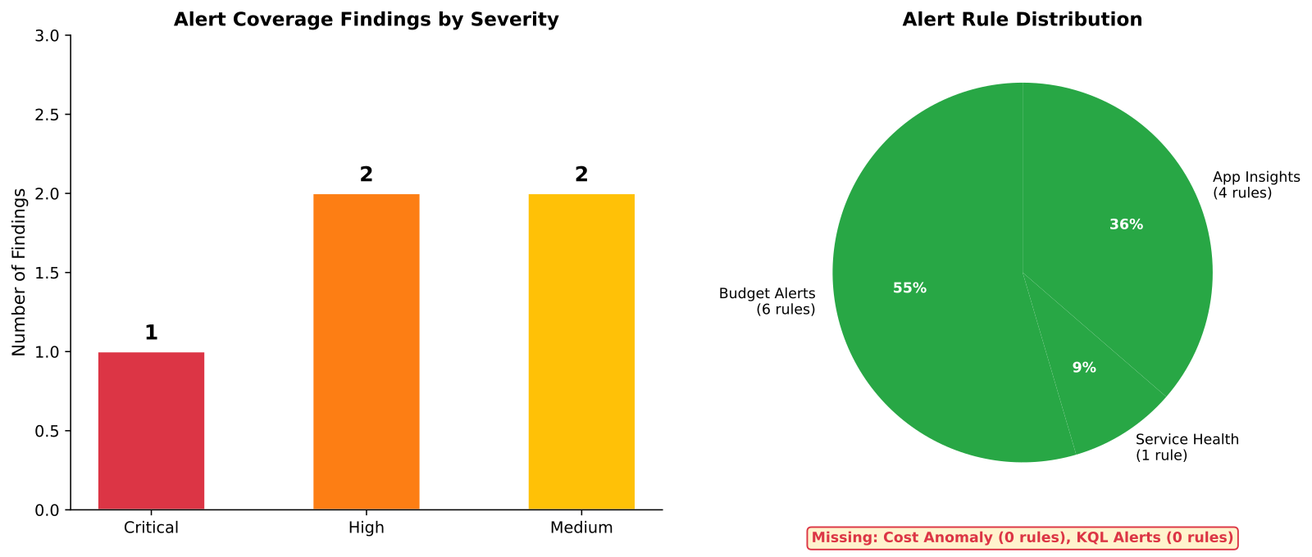
The answer
alert-coverage-audit proves the monitoring gap: 0 cost anomaly alerts and 0 scheduled query rules in the current estate.
advisor-suppression-review adds governance proof: 1 orphaned suppression with no owner, TTL, or justification.
The release adds named write tools and governance tools: deploy-anomaly-alert, deploy-bulk-anomaly-alerts, suppress-advisor-recommendations, and resource-graph-query.
The answer is not "more charts." It is operational coverage where native CM is thin.
🟢 Asks #48
Notes:
Use the chart and the suppression finding together. The customer challenge is fair, so answer it with evidence, not position. The environment on screen has no cost anomaly alerts and no KQL alert layer, and it also has a governance miss around an orphaned Advisor suppression. That is where the agent adds value: not by duplicating native charts, but by auditing what is missing, deploying the missing path, and keeping the result in a scheduled operating cadence. That is a stronger answer than a feature checklist because it starts from the actual gap in the customer estate.
Sources: MCAPS ask #48 — "Azure CM native gaps"
Canonical: memory://work/mcaps/mcaps-internal-asks-finops-toolkit-azure-capacity-ai-cost-may-2026
Coverage verdict per canonical: 🟢 ships-today | 🟡 partial | 🔴 out-of-scope
Evidence pack: src/templates/sre-agent/training/release-deck/evidence/tasks/advisor-suppression-review.md
Chart proof: src/templates/sre-agent/training/release-deck/charts/svg/alert-gap-analysis.svg

Slide 79
The details
alert-coverage-audit.yaml — cron 0 8 16 .
advisor-suppression-review.yaml — cron 0 9 1 .
Native gap proof from the run: 0 cost anomaly alerts, 0 scheduled query rules, and 1 orphaned suppression with no owner or TTL.
Added control surfaces: deploy-anomaly-alert, deploy-bulk-anomaly-alerts, suppress-advisor-recommendations, resource-graph-query, and PostTeamsMessage.
Monday move: run the audit, clean one suppression, and deploy one anomaly alert.
🟢 Asks #48
Notes:
Stay practical. The value story here is not that the release replaces Azure Cost Management. It is that the release turns the missing pieces into an operating loop with named tasks and write paths. Show the cron lines, then point at the three gaps the current estate already proved. That gives the field a crisp answer when the customer says "why not just stay native?" The right reply is: use native where it is enough, and use the agent where the environment still has no anomaly chain, no KQL alert layer, and weak governance around suppression state.
Sources: MCAPS ask #48 — "Azure CM native gaps"
Canonical: memory://work/mcaps/mcaps-internal-asks-finops-toolkit-azure-capacity-ai-cost-may-2026
Coverage verdict per canonical: 🟢 ships-today | 🟡 partial | 🔴 out-of-scope
Evidence pack: src/templates/sre-agent/training/release-deck/evidence/tasks/alert-coverage-audit.md
Chart proof: src/templates/sre-agent/training/release-deck/charts/svg/alert-gap-analysis.svg

Slide 80
The ask
“Who runs this after we leave?”
Post-deploy operations model
🟢 Asks #55
Notes:
This ask lands late in the deal and it is usually decisive. The customer is not asking for another dashboard. The customer is asking for an operating model that survives after the partner exits. You answer that by pointing to the schedule, not a named person. The deck should make that shift explicit. The post-deploy steady state is a recurring task system with Teams delivery, named tools, named subagents, and exception handling by humans. That is the finance answer because it changes the cost of operating the motion after the project ends.
Sources: MCAPS ask #55 — "FTK supportability + ops: Post-deploy ops model — “who runs this after we leave?”"
Canonical: memory://work/mcaps/mcaps-internal-asks-finops-toolkit-azure-capacity-ai-cost-may-2026
Coverage verdict per canonical: 🟢 ships-today
Evidence pack: src/templates/sre-agent/training/release-deck/evidence/tasks/capacity-daily-monitor.md
Chart proof: src/templates/sre-agent/training/release-deck/charts/svg/quarterly-maturity-radar.svg

Slide 81
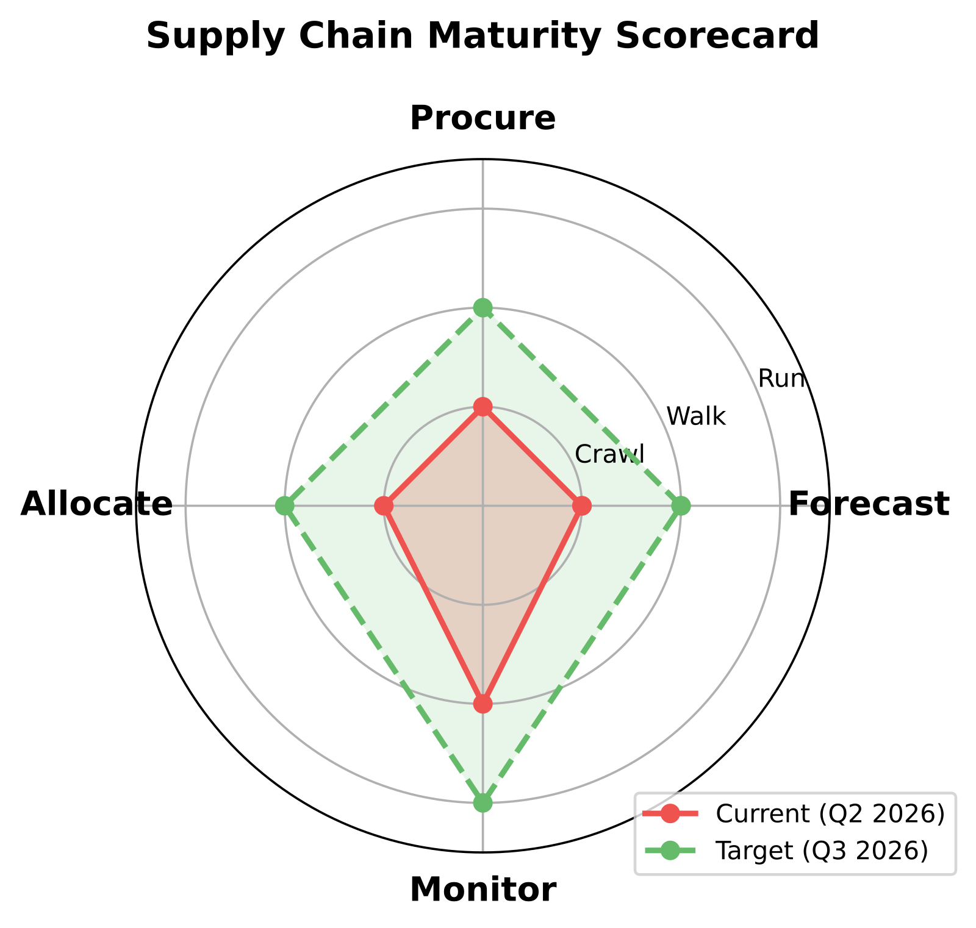
The answer
The schedule runs it.
src/templates/sre-agent/CATALOG.md defines 18 scheduled tasks across daily, weekly, monthly, and quarterly rhythms. PostTeamsMessage posts the output, and 5 subagents, 3 skills, and 33 tools keep the motion running without a human operator in steady state.
The maturity radar shows the operating model improving over time instead of waiting for the next consultant review.
🟢 Asks #55
Notes:
You answer the ops-model question with the catalog and the runtime counts. There are 18 scheduled tasks, split across core FinOps and capacity-management rhythms. Five subagents, three skills, and 33 tools execute the work. Teams is the delivery surface. Humans still make decisions, but the repetitive collection, analysis, and posting do not depend on someone remembering the calendar. That is the key finance value. The customer is not buying a report. The customer is adopting a recurring operating system that keeps running after project sign-off and keeps building evidence quarter after quarter.
Sources: MCAPS ask #55 — "FTK supportability + ops: Post-deploy ops model — “who runs this after we leave?”"
Canonical: memory://work/mcaps/mcaps-internal-asks-finops-toolkit-azure-capacity-ai-cost-may-2026
Coverage verdict per canonical: 🟢 ships-today
Evidence pack: src/templates/sre-agent/training/release-deck/evidence/tasks/capacity-daily-monitor.md
Chart proof: src/templates/sre-agent/training/release-deck/charts/svg/quarterly-maturity-radar.svg

Slide 82
The details
Catalog: src/templates/sre-agent/CATALOG.md
Rhythm: daily 0 6 , weekly 0 8 1, monthly 0 9 1 , quarterly 0 9 1 1,4,7,10
Delivery runtime: scheduled tasks + Teams connector + PostTeamsMessage
Monday move: srectl scheduledtask list
🟢 Asks #55
Notes:
You make the answer operational here. The catalog shows the exact cadence: daily checks, weekly reviews, monthly finance packs, and quarterly strategy. That is why “who runs it” becomes “what schedule runs it.” You can also make the scope tangible: nine core tasks and nine capacity and governance tasks cover the recurring estate motion. Partners still stand it up and coach the first loop. After that, the runbook is the schedule itself. On Monday, list the tasks, pick one, and show the customer that the steady-state model already exists.
Sources: MCAPS ask #55 — "FTK supportability + ops: Post-deploy ops model — “who runs this after we leave?”"
Canonical: memory://work/mcaps/mcaps-internal-asks-finops-toolkit-azure-capacity-ai-cost-may-2026
Coverage verdict per canonical: 🟢 ships-today
Evidence pack: src/templates/sre-agent/training/release-deck/evidence/tasks/capacity-daily-monitor.md
Chart proof: src/templates/sre-agent/training/release-deck/charts/svg/quarterly-maturity-radar.svg

Slide 83
The ask
“&gt; "Is FTK Microsoft-supported?"”
“&gt; "Will Microsoft pull this in 12 months?"”
“&gt; "When CSS punts, who owns the escalation?"”
🔴 Asks #49, #50, #51
Notes:
Let this slide be uncomfortable. These are some of the most frequent trust questions in the whole corpus, and the room will hear them again next week. Do not soften them. The value of the cluster is honesty. Your customer deserves a clear support model, a clear non-support model, and a practical next step when something breaks. The next two slides answer that directly without pretending this release creates a CSS-backed product support promise it does not have.
Sources: MCAPS asks #49, #50, #51 — "Is FTK Microsoft-supported?"; "Will Microsoft pull this?"; "Support escalation path"
Canonical: memory://work/mcaps/mcaps-internal-asks-finops-toolkit-azure-capacity-ai-cost-may-2026
Coverage verdict per canonical: 🟢 ships-today | 🟡 partial | 🔴 out-of-scope
Evidence pack: None
Chart proof: None

Slide 84
The answer
The support model is community OSS plus GitHub Issues, with agent diagnostics such as hubs-health-check to tighten repro quality.
The model is not CSS case ownership for FTK, not an SLA, and not phone support for the toolkit itself.
Your partner or field engagement model still matters: use the diagnostics, document the issue, and route platform issues to the actual owning team when the gap is outside FTK.
Credibility comes from saying this early, not after the customer tries to open the wrong ticket.
🔴 Asks #49, #50, #51
Notes:
Deliver this calmly and directly. The audience will trust the rest of the deck more if you do not flinch here. FTK is an open-source community offering with a GitHub-based support motion. The agent helps by producing better diagnostics and cleaner issue evidence, but it does not convert the toolkit into a first-party product with SLA-backed escalation. That does not make the release weak. It makes the escalation path clearer: toolkit issues go to the community and GitHub, and platform issues go to the service owner with better evidence in hand.
Sources: MCAPS asks #49, #50, #51 — "Is FTK Microsoft-supported?"; "Will Microsoft pull this?"; "Support escalation path"
Canonical: memory://work/mcaps/mcaps-internal-asks-finops-toolkit-azure-capacity-ai-cost-may-2026
Coverage verdict per canonical: 🟢 ships-today | 🟡 partial | 🔴 out-of-scope
Evidence pack: None
Chart proof: None

Slide 85
The details
What it is: OSS community, GitHub Issues, reproducible evidence from scheduled tasks, and field or partner sponsorship when a customer program needs air cover.
What it is not: CSS ownership for FTK, an SLA, phone support, or a promise that Microsoft will absorb every toolkit issue as a product bug.
Best practice: run hubs-health-check, capture the failing task evidence, open the GitHub issue, then route true platform defects to the owning product team.
Monday move: standardize the issue template and attach diagnostics before escalation.
🔴 Asks #49, #50, #51
Notes:
This last slide turns honesty into a workable operating model. If a customer asks for support posture, give them the exact contract. If they ask how to escalate, give them the exact sequence: run diagnostics, attach the proof, open the issue, then distinguish toolkit issues from Azure platform issues. That is the safe and credible path. The field does not need to apologize for the OSS model. They need to explain it clearly and show that the release improves the evidence quality that moves any later escalation faster.
Sources: MCAPS asks #49, #50, #51 — "Is FTK Microsoft-supported?"; "Will Microsoft pull this?"; "Support escalation path"
Canonical: memory://work/mcaps/mcaps-internal-asks-finops-toolkit-azure-capacity-ai-cost-may-2026
Coverage verdict per canonical: 🟢 ships-today | 🟡 partial | 🔴 out-of-scope
Evidence pack: None
Chart proof: None

Slide 86
What you've heard / what's next
You heard a run-the-shop answer: scheduled tasks, named tools, Teams delivery, and honest verdicts.
Monday moves: run hubs-health-check, mom-report, budget-coverage-audit, alert-coverage-audit, benefit-recommendation-review, and ai-workload-cost-analysis against the customer Hub.
Use the honest slides to route out-of-scope asks to Azure AI Foundry PG, CSS/SGS/UAT, Commerce/Cost Management, the FTK OSS community, and FinOps CoE or Gov owners.
Next: pick the first three live tasks, wire the Teams channel, and turn the customer review into an operating cadence.
Notes:
Close Part 2 by restating the shape of the answer. The release is strongest when you position it as a calendar of recurring operating work with real evidence and named boundaries. The field should leave with two moves: first, pick a small live task set and run it against the customer Hub; second, use the honest slides to route the asks this release does not own. That combination is what keeps the conversation credible. You are not selling one more dashboard. You are installing a working FinOps and capacity operating rhythm with explicit ownership lines.
Sources: MCAPS asks #21, #24, #25, #27, #36, #41, #43, #48, #49 — "Operate motion across cadence, AI cost, reconciliation, allocation, and supportability"
Canonical: memory://work/mcaps/mcaps-internal-asks-finops-toolkit-azure-capacity-ai-cost-may-2026
Coverage verdict per canonical: 🟢 ships-today | 🟡 partial | 🔴 out-of-scope
Evidence pack: src/templates/sre-agent/training/release-deck/deck-outline-v8.md
Chart proof: None

Slide 87
AOAI platform gaps stay with Azure AI Foundry PG
Ask #3: AOAI throttling and runtime behavior stay with Azure AI Foundry PG.
Ask #4: region and capacity-side AOAI platform gaps stay with Azure AI Foundry PG.
Ask #5: model lifecycle and GA timing stay with Azure AI Foundry PG.
Ask #6: AOAI service-side platform controls stay with Azure AI Foundry PG.
Field move: carry FTK cost and capacity evidence into the PG conversation; do not position FTK as the platform owner.
Notes:
Keep this slide clean and matter-of-fact. The point is not to apologize for the boundary. The point is to stop the room from misrouting the ask. These four asks sit with the Azure AI Foundry product group because they are service behavior, platform capacity, model lifecycle, and service-control questions. The toolkit can add evidence around cost, cadence, and diagnostics, but it does not own AOAI service throttling, model GA timing, or platform-side controls. That owner mapping is what keeps the customer from getting bounced between teams.
Sources: MCAPS asks #3, #4, #5, #6 — "AOAI throttling / runtime behavior"; "AOAI region and platform capacity"; "Model GA timing"; "AOAI platform controls"
Canonical: memory://work/mcaps/mcaps-internal-asks-finops-toolkit-azure-capacity-ai-cost-may-2026
Coverage verdict per canonical: 🟢 ships-today | 🟡 partial | 🔴 out-of-scope
Evidence pack: None
Chart proof: None

Slide 88
Capacity process gaps stay with CSS, SGS, UAT, and Azure capacity
Ask #15: SGS capacity-blocked milestones stay with CSS, SGS process, and Azure capacity supply teams.
Ask #16: escalation-path and approval-process friction stay with CSS, SGS, and UAT process owners.
Ask #22: procurement and request-process latency stay with UAT process and Azure capacity teams.
Field move: use agent evidence for demand, quota, and impact, then route the process ask to the right owner.
Notes:
Tell the field exactly why these asks are out of scope. They are not missing because the toolkit team forgot them. They are process and approval-path issues that sit with CSS, SGS, UAT, and the Azure capacity organization. The agent can help with evidence: quota headroom, demand patterns, region impact, and current blockers. It cannot rewire the approval path or shorten a procurement queue by itself. That means the right operating pattern is evidence plus correct owner routing, not evidence plus a false promise that the toolkit will clear the process bottleneck.
Sources: MCAPS asks #15, #16, #22 — "SGS capacity-blocked milestones"; "Capacity escalation/process friction"; "Procurement and request-process latency"
Canonical: memory://work/mcaps/mcaps-internal-asks-finops-toolkit-azure-capacity-ai-cost-may-2026
Coverage verdict per canonical: 🟢 ships-today | 🟡 partial | 🔴 out-of-scope
Evidence pack: None
Chart proof: None

Slide 89
Commerce and Cost Management own multi-cloud, MCA, and allocation platform gaps
Ask #39: multi-cloud cost normalization stays with the broader commerce and management platform stack, not this FTK release.
Ask #40: commerce and billing-model gaps across MCA constructs stay with Commerce and Cost Management owners.
Ask #31: allocation platform gaps beyond current tag and hierarchy evidence stay with Cost Management platform owners.
Field move: use FTK for Azure evidence, then route cross-cloud and commerce-model asks to the platform owner.
Notes:
This slide keeps the field from overextending the Azure answer into a multi-cloud or commerce-platform promise. The release is strong inside Azure cost evidence, cadence, and operating workflow. It is not the owner for cross-cloud normalization, MCA platform semantics, or every allocation feature a finance team may want from the commerce stack. Say that directly. Then remind the room that the toolkit still helps by making the Azure side of the evidence clearer, which often makes the handoff to the Commerce or Cost Management team much faster and much less emotional.
Sources: MCAPS asks #39, #40, #31 — "Multi-cloud cost management"; "MCA commerce-model gaps"; "Allocation platform gaps"
Canonical: memory://work/mcaps/mcaps-internal-asks-finops-toolkit-azure-capacity-ai-cost-may-2026
Coverage verdict per canonical: 🟢 ships-today | 🟡 partial | 🔴 out-of-scope
Evidence pack: None
Chart proof: None

Slide 90
FTK community support stays in OSS and GitHub
Ask #49: supportability question stays with the FTK OSS community and GitHub.
Ask #50: product-lifecycle anxiety stays with clear OSS governance and roadmap communication, not a CSS promise.
Ask #51: escalation-path confusion stays with honest routing and issue hygiene.
Ask #44 and #54: program and community-operating questions stay with the FTK OSS community plus GitHub workflow, not a product SLA.
Field move: standardize diagnostics, issue templates, and owner routing.
Notes:
This slide extends the supportability cluster beyond the top three asks. Keep the tone calm and practical. The community model is not a weakness if the customer hears it early and hears it consistently. That means the field should talk about GitHub issues, operating evidence, community governance, and roadmap transparency as the support pattern. It also means the field must not imply that OSS governance questions or feedback-loop asks have a hidden product-team SLA behind them. Clarity is the win here, not spin.
Sources: MCAPS asks #49, #50, #51, #44, #54 — "Is FTK Microsoft-supported?"; "Will Microsoft pull this?"; "Support escalation path"; "FTK community operating model"; "Field feedback and community loop"
Canonical: memory://work/mcaps/mcaps-internal-asks-finops-toolkit-azure-capacity-ai-cost-may-2026
Coverage verdict per canonical: 🟢 ships-today | 🟡 partial | 🔴 out-of-scope
Evidence pack: None
Chart proof: None

Slide 91
Enablement and governance stay with the FinOps CoE and field programs
Ask #42: practice enablement gaps stay with the FinOps CoE and field enablement owners.
Ask #67: maturity coaching and field readiness stay with the FinOps CoE and enablement leads.
Ask #72 and #73: government and governance-specific policy asks stay with Gov and policy owners.
Ask #65: operating-governance accountability stays with the customer governance team and field program owners.
Field move: use the toolkit evidence in the meeting, then route policy and enablement asks to the right program owner.
Notes:
End the honest section on governance, not on product gaps. Many of these asks sound like feature requests, but they are really enablement, policy, and organizational-accountability problems. The toolkit can help those meetings by bringing evidence, cadence, and a repeatable operating pattern. It does not replace a FinOps CoE, a government cloud policy owner, or a field enablement motion. If you name those owners directly, you keep the customer from waiting on engineering for something that is actually a people-and-policy decision.
Sources: MCAPS asks #42, #67, #72, #73, #65 — "Enablement gaps"; "Field maturity coaching"; "Government-cloud governance"; "Governance-specific policy asks"; "Operating-governance accountability"
Canonical: memory://work/mcaps/mcaps-internal-asks-finops-toolkit-azure-capacity-ai-cost-may-2026
Coverage verdict per canonical: 🟢 ships-today | 🟡 partial | 🔴 out-of-scope
Evidence pack: None
Chart proof: None

Slide 92
The Monday after this deck
1. Pick one customer hub and run srectl scheduledtask invoke capacity-daily-monitor.
2. Read the Teams card with your customer and agree the first exception to fix.
3. Book 30 minutes with the customer’s finance contact and walk the YTD report.
Notes:
This is the adoption slide. If the field remembers one move, it is this one. On Monday, do not start with architecture. Start with one running task, one live Teams card, and one finance conversation. That sequence turns the deck into customer evidence fast. It also answers the quiet adoption risk: the deck only matters if it produces a recurring motion in the customer estate. Pick the hub, run the task, read the card, and put finance in the loop the same day.
Sources: MCAPS asks #55,#70 — "FTK supportability + ops: Post-deploy ops model — “who runs this after we leave?”"; "FTK enablement + adoption: Dashboard adoption failure"
Canonical: memory://work/mcaps/mcaps-internal-asks-finops-toolkit-azure-capacity-ai-cost-may-2026
Coverage verdict per canonical: 🟢 ships-today
Evidence pack: src/templates/sre-agent/training/release-deck/evidence/tasks/capacity-daily-monitor.md
Chart proof: src/templates/sre-agent/training/release-deck/charts/svg/fy-cost-trend-forecast.svg

Slide 93
Resources and next steps
GitHub repo: https://github.com/microsoft/finops-toolkit/tree/dev/src/templates/sre-agent
Task catalog: https://github.com/microsoft/finops-toolkit/blob/dev/src/templates/sre-agent/CATALOG.md
Deployment guide: https://github.com/microsoft/finops-toolkit/blob/dev/src/templates/sre-agent/README.md
Community Teams channel: use the release enablement Teams space for follow-up threads
Session recording: use the training post recording link for replay and customer prep
Notes:
You end with the operating references the field actually reuses. The repo shows the template. The catalog shows the running schedule. The README shows deployment steps and post-deploy expectations. The Teams space and recording keep the material live after the session ends. This slide matters because supportability questions arrive immediately after interest appears. Give the audience the exact places to go next so the conversation moves from curiosity to deployment planning without another search cycle.
Sources: MCAPS asks #49,#53,#55 — "FTK supportability + ops: “Is FTK Microsoft-supported? Who do I call?”"; "FTK supportability + ops: Deployment complexity (“very heavy touch”)"; "FTK supportability + ops: Post-deploy ops model — “who runs this after we leave?”"
Canonical: memory://work/mcaps/mcaps-internal-asks-finops-toolkit-azure-capacity-ai-cost-may-2026
Coverage verdict per canonical: 🟡 partial
Evidence pack: src/templates/sre-agent/training/release-deck/evidence/tasks/hubs-health-check.md
Chart proof: src/templates/sre-agent/training/release-deck/charts/svg/quarterly-maturity-radar.svg

Slide 94
Thank you / Q&A
Notes:
You close with two goals: keep the room open for finance and architecture questions, and give the audience one clear route back to the team after the session. The thank-you slide is also the honesty slide. If the first question is supportability, roadmap, or scope boundary, answer it directly and point back to the repo, catalog, and deployment guide. That keeps the training credible and keeps the next step concrete instead of vague.
Sources: MCAPS ask #49 — "FTK supportability + ops: “Is FTK Microsoft-supported? Who do I call?”"
Canonical: memory://work/mcaps/mcaps-internal-asks-finops-toolkit-azure-capacity-ai-cost-may-2026
Coverage verdict per canonical: 🔴 out-of-scope
Evidence pack: src/templates/sre-agent/training/release-deck/evidence/tasks/hubs-health-check.md
Chart proof: src/templates/sre-agent/training/release-deck/charts/svg/quarterly-maturity-radar.svg

